Slide 1
2023 KTS AGM
7pm - November 7, 2023
at the KIMBERLEY NORDIC CENTRE
Join online: meet.google.com/nqw-xujf-fxm
Building & Maintaining
Great Trail Networks in Kimberley
Cooperation | Sustainability | Respect

Slide 2
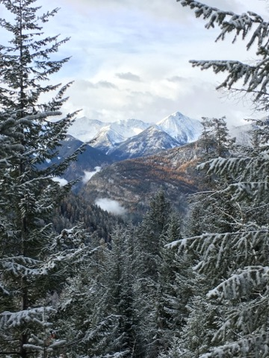
TONIGHT’S AGENDA
2023 AGM AGENDA
Welcome and introductions
Kimberley Trails Society update
1.0 - Society Overview
2.0 - Financial Report
3.0 - 2023 Major Projects
4.0 - In 2024, Get Involved!
Election of Directors for 2024

Slide 3
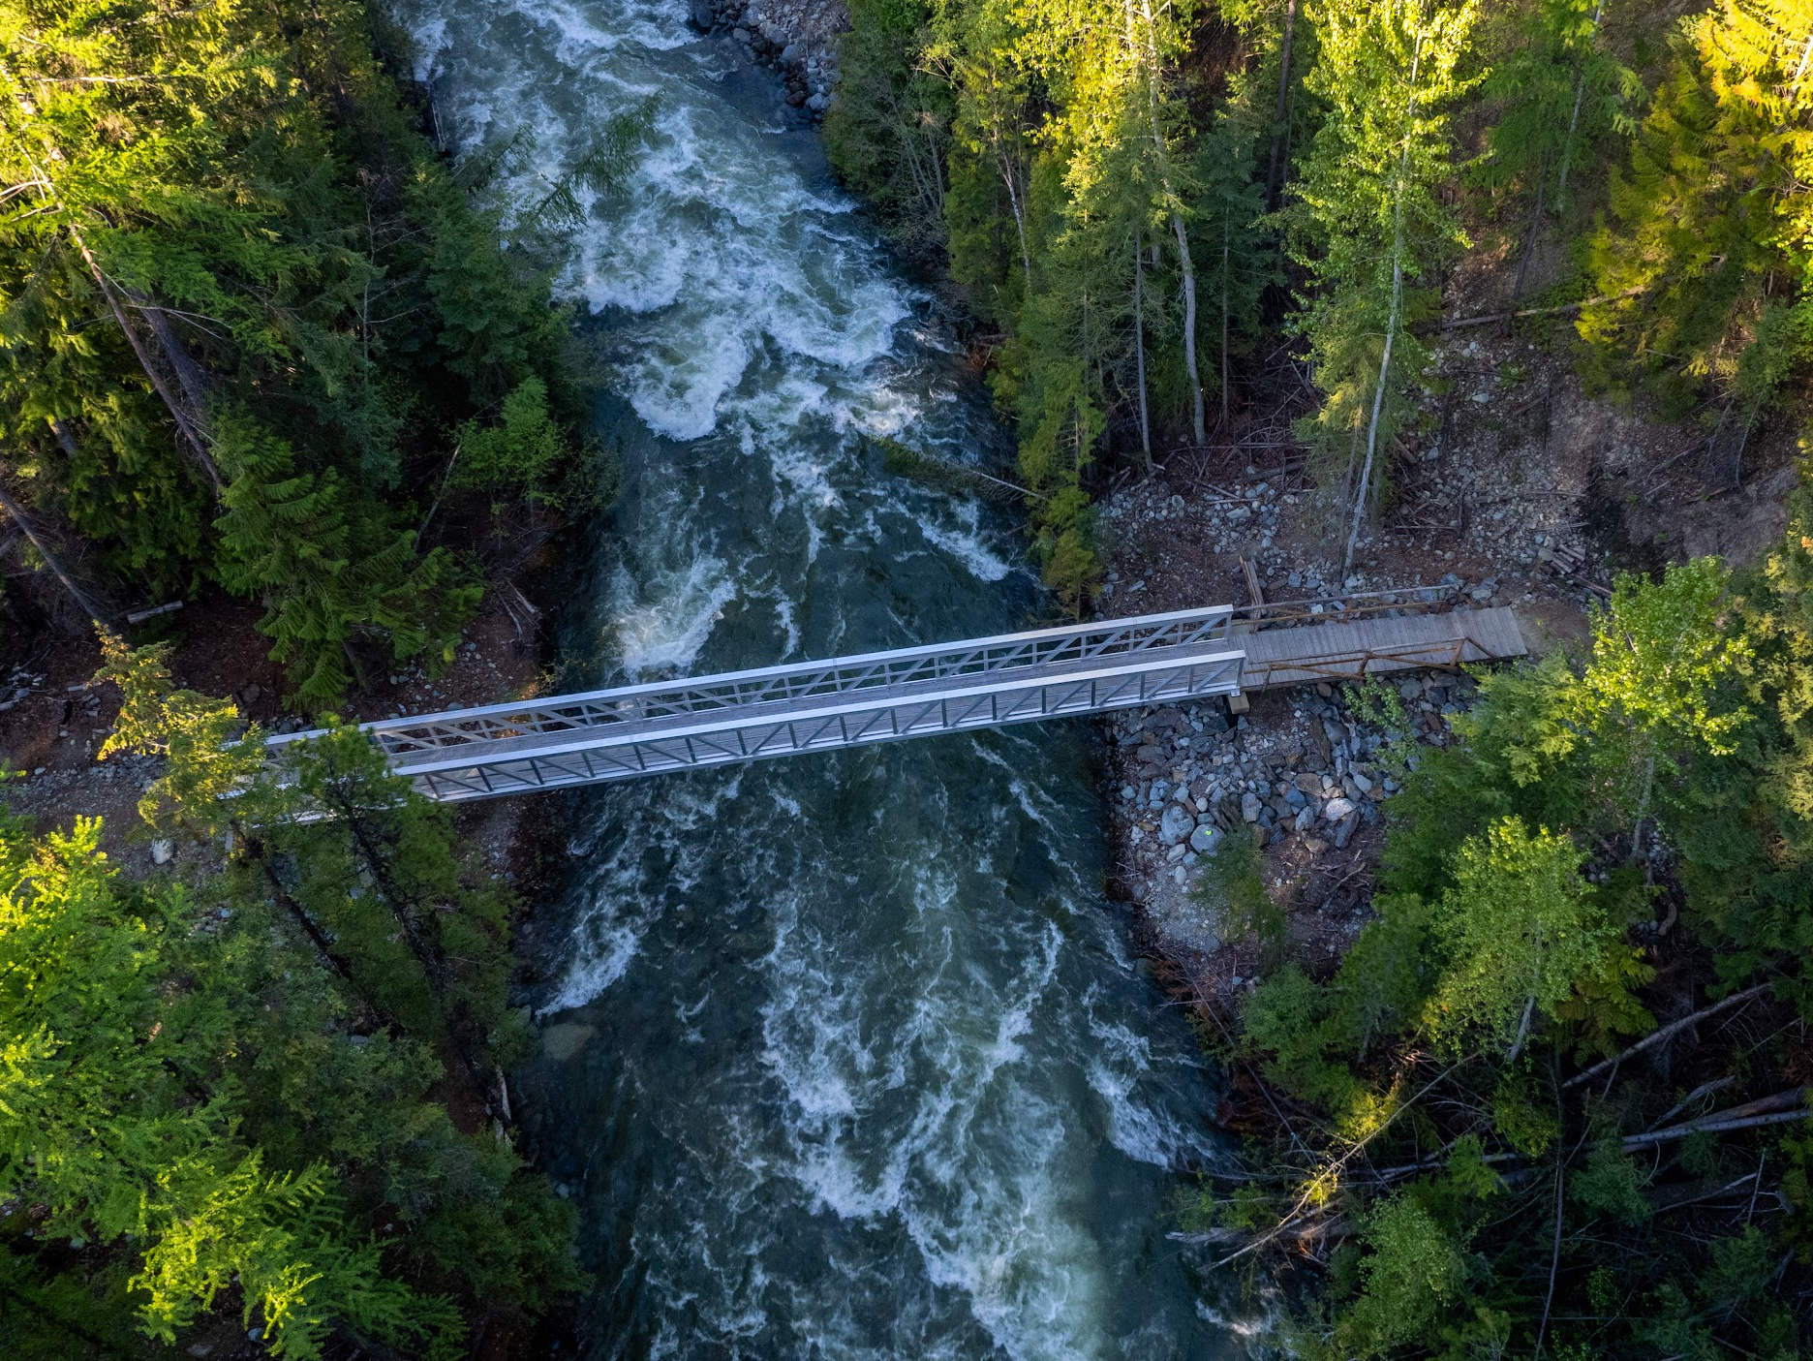
Land Acknowledgement
“ The Kimberley Trails Society would like to begin by acknowledging that we are fortunate to be able to conduct our work within the territory of the Ktunaxa Nation. We are committed to working in partnership with the Ktunaxa Nation as stewards of Ktunaxa ?amak?is.”

Slide 4
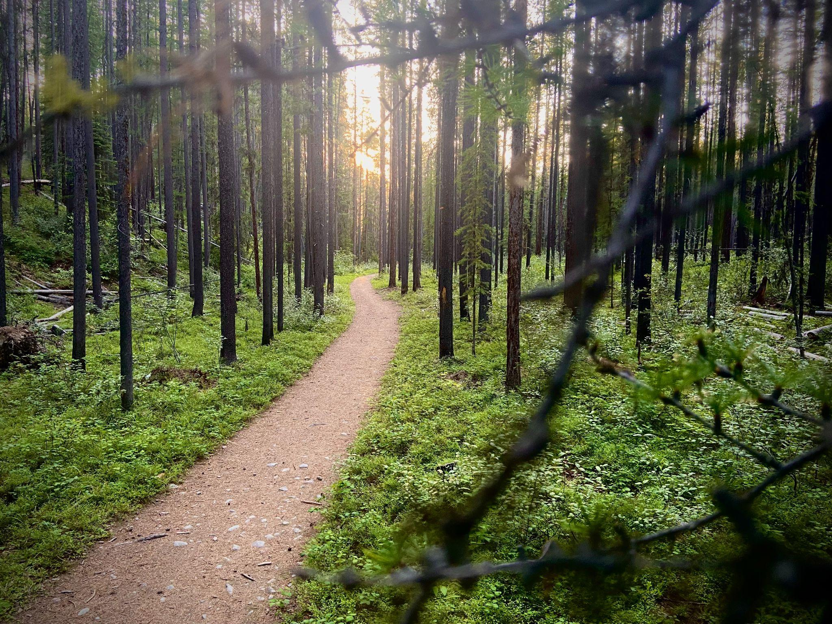
WHAT DOES KTS DO FOR YOU?
“ The Kimberley Trails Society helps develop, maintain,
and protect trails in Kimberley and the surrounding area.”
Cooperation .
Sustainability .
Respect .

Slide 5
KTS COMMUNITY PARTNERS
City of Kimberley
Rec Sites and Trails BC
Kimberley Nature Park Society
Kimberley Nordic Club
Kimberley Alpine Resort/RCR
Tourism Kimberley
Ktunaxa Nation
Round the Mountain Festival
Teck/Anthem United
Trans Canada Trail
Kimberley Riverside Campground
Purcell Golf & International School
Friends of Lois Creek
Private contractors
Race Organizers
Wildsight
BC Wildfire Service
Canfor / Logging

Slide 6
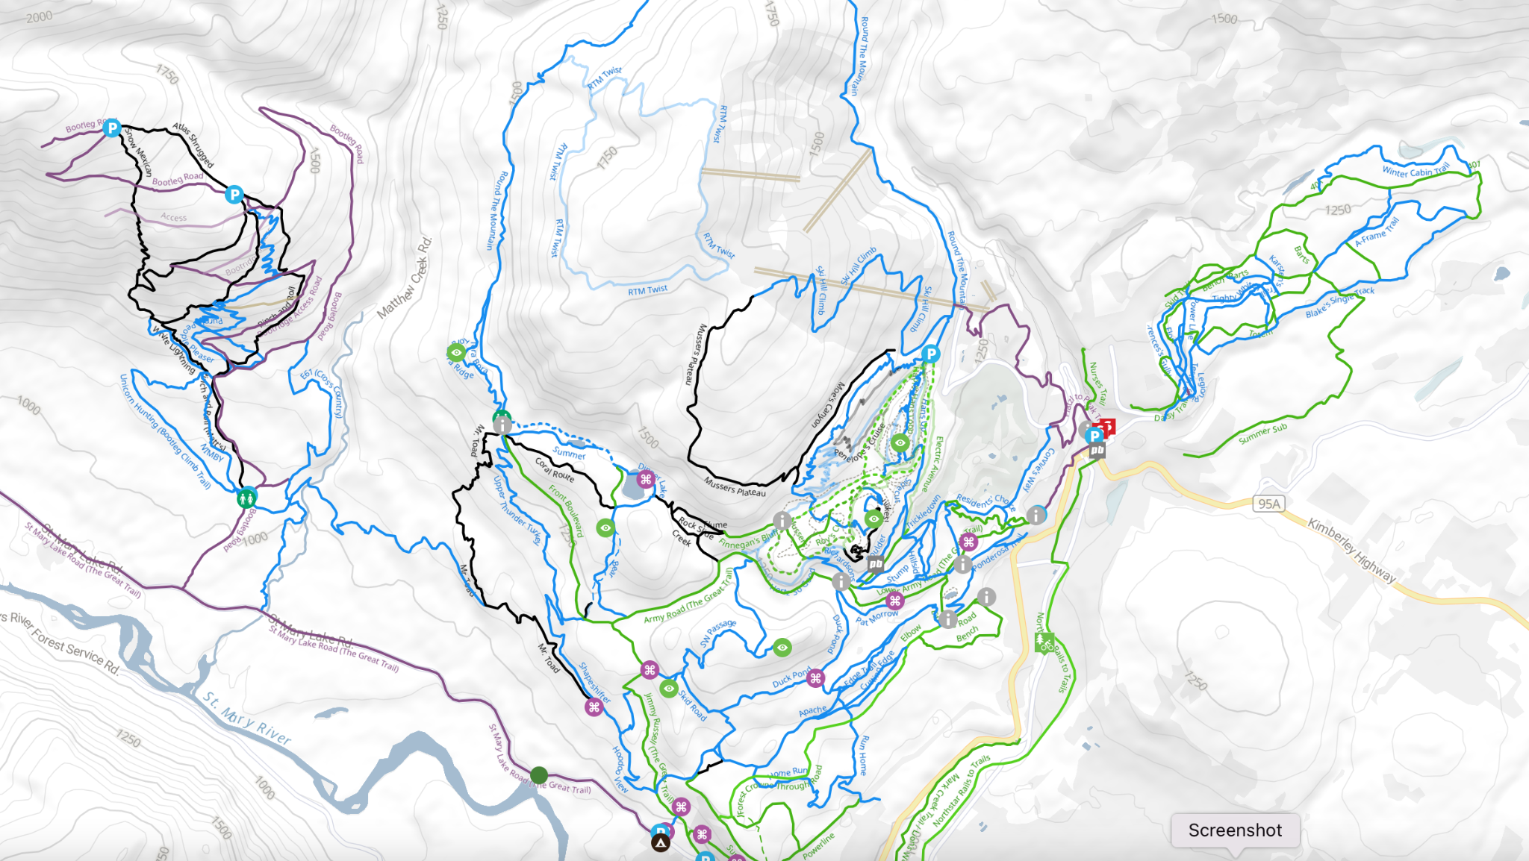
Managed and Supported Areas
Bootleg
RCR
Matthew Creek
Lois Creek
HBV
KNC
KNP
Levirs
Forest Crown
Campground

Slide 7
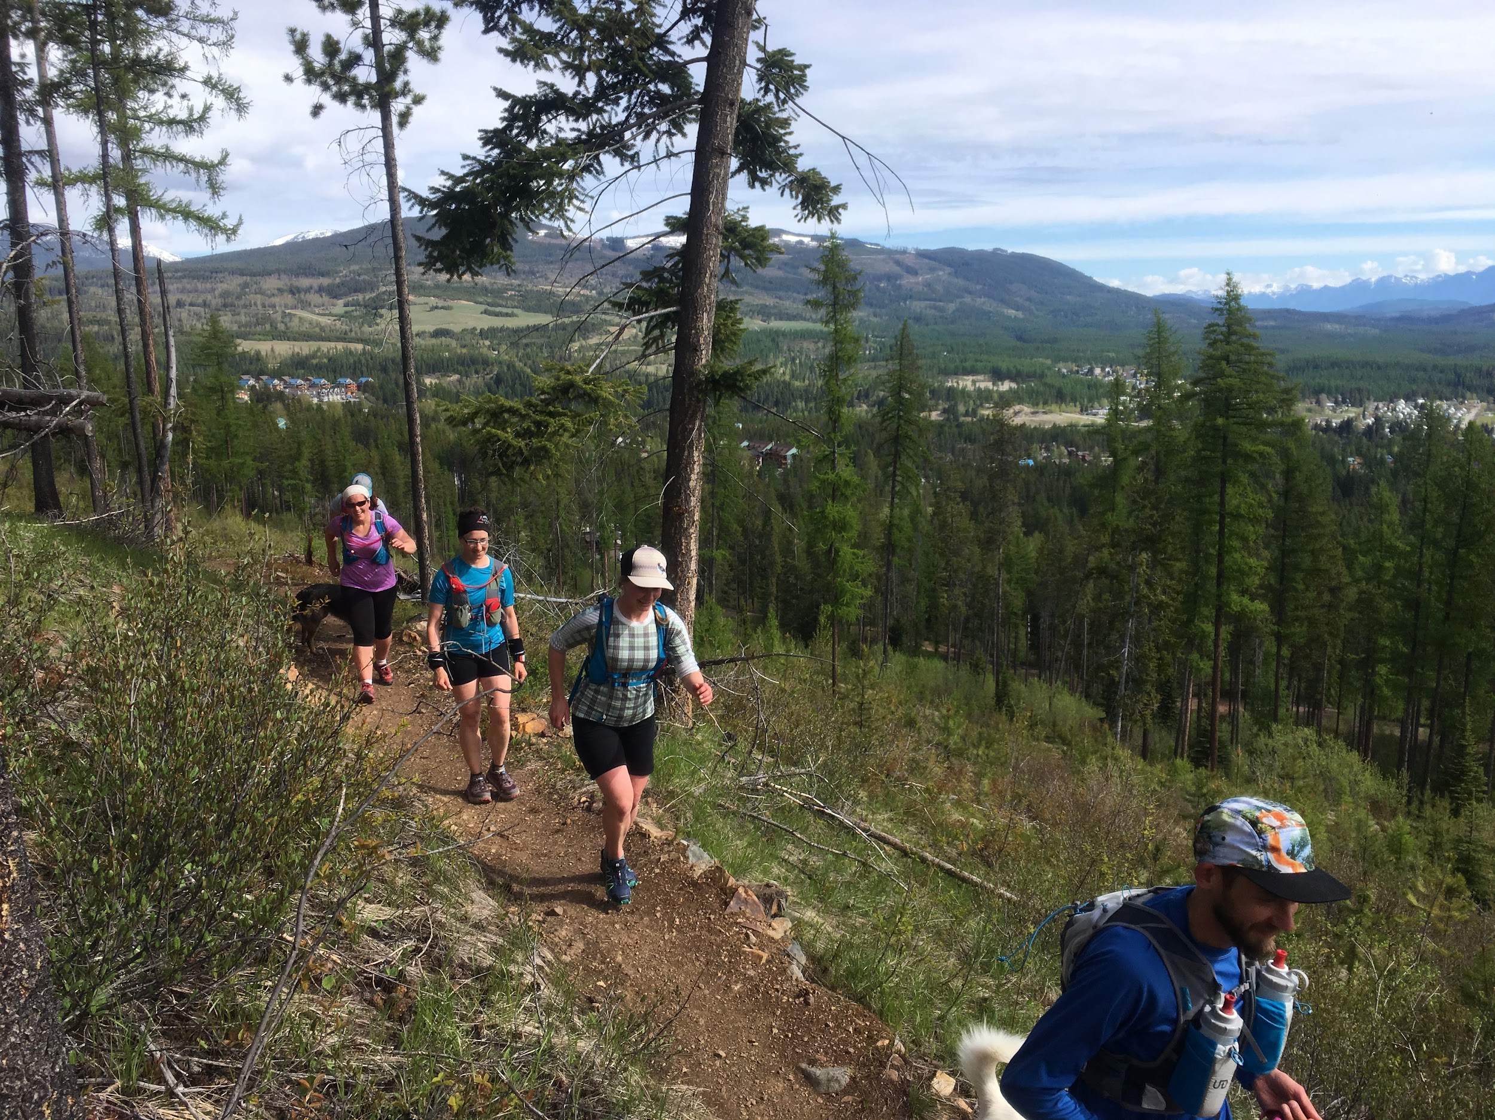
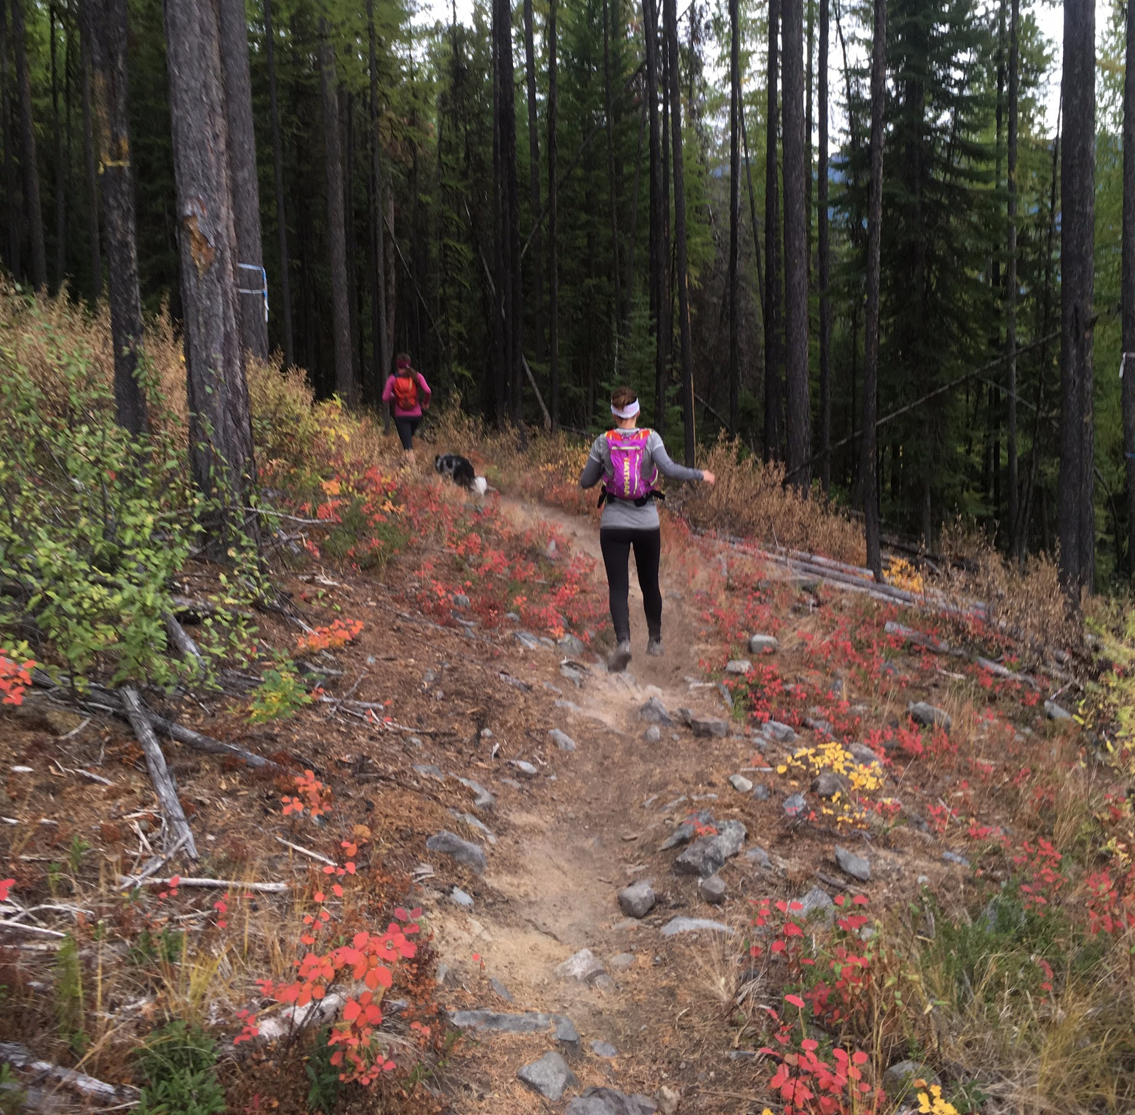
KTS MANAGED TRAIL AREAS
Lois Creek (Friends of Lois Creek)
Pyramid Creek Trail
Bootleg Recreation Site
Mr Toad and Thunder Turkey
Campground Trails - Jim Ritchie Trail, John Swift Memorial Loop
Round the Mountain Trail
Kimberley Nordic Center
Levirs Area
Forest Crown Trails

Slide 8
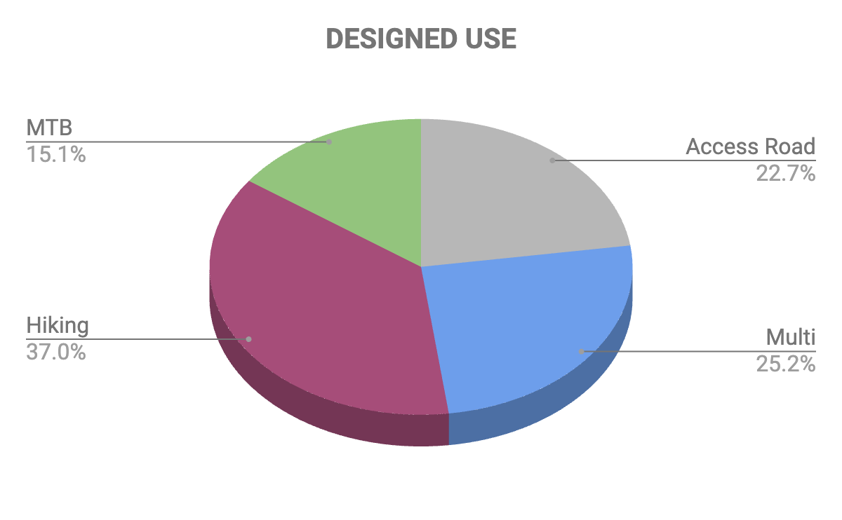
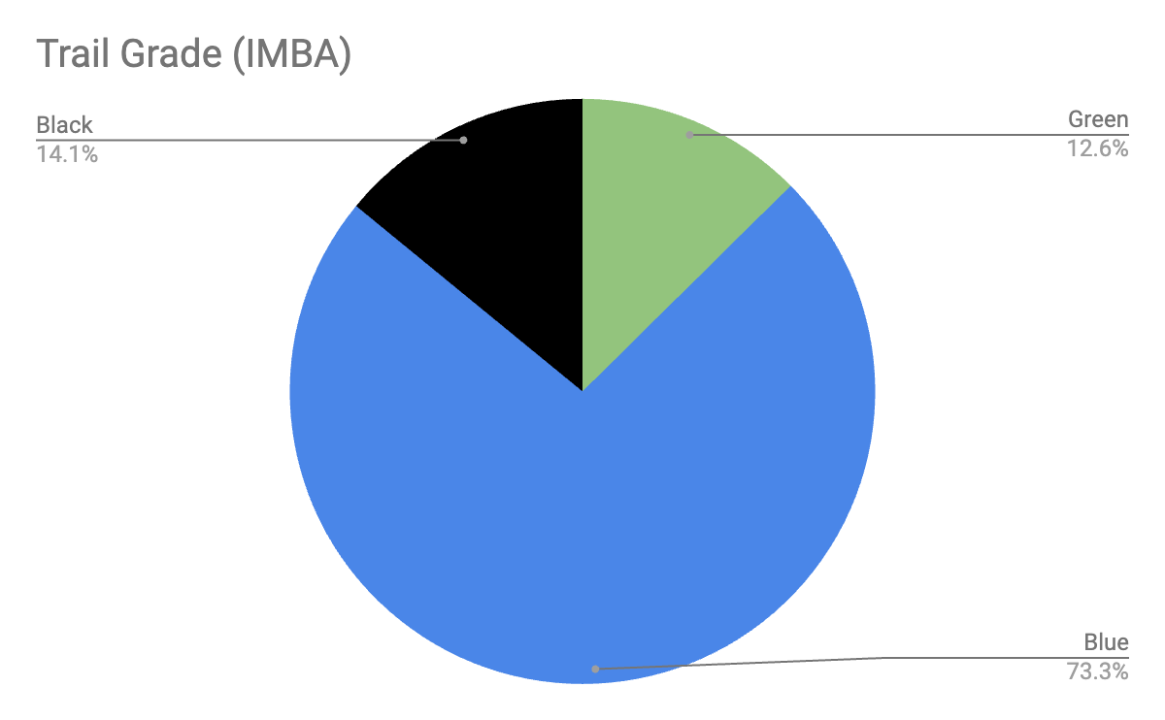
Kimberley Trail Data

Slide 9
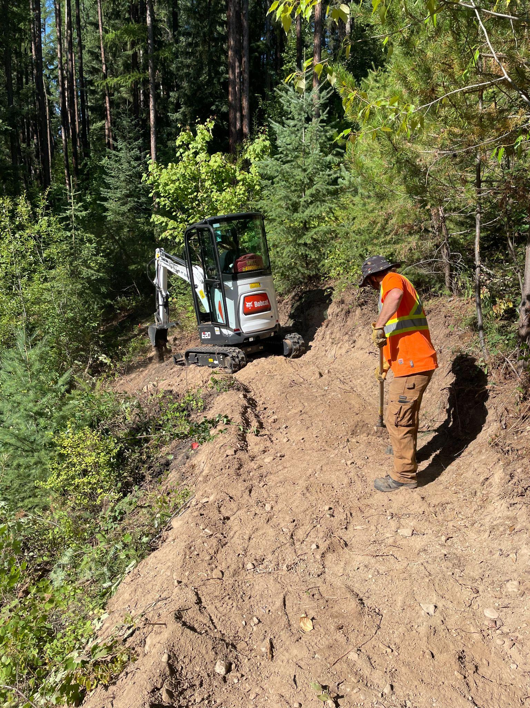
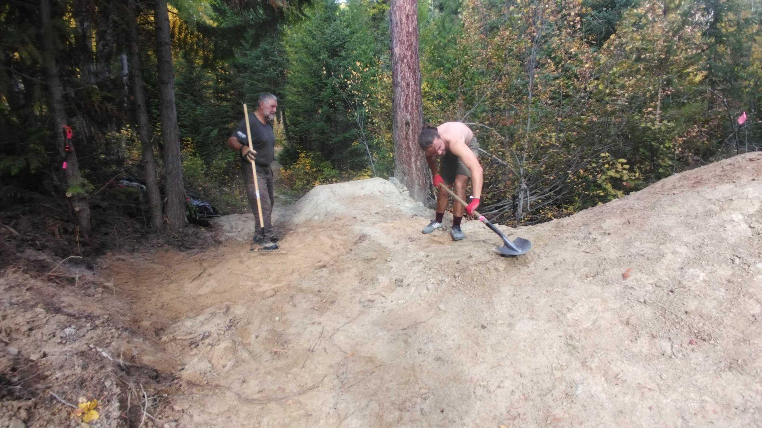
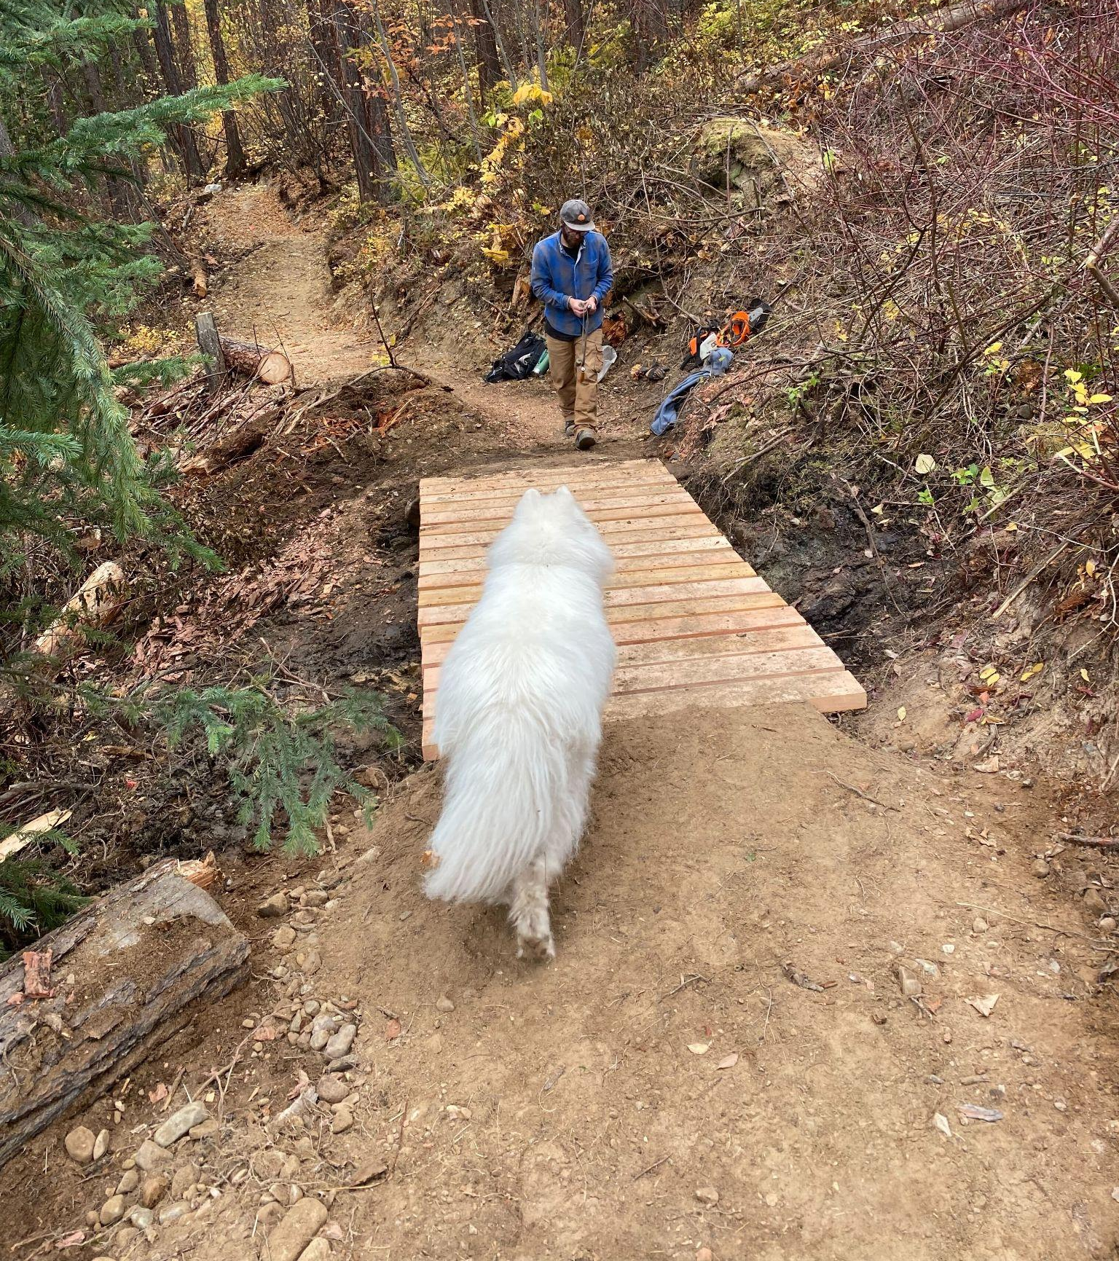
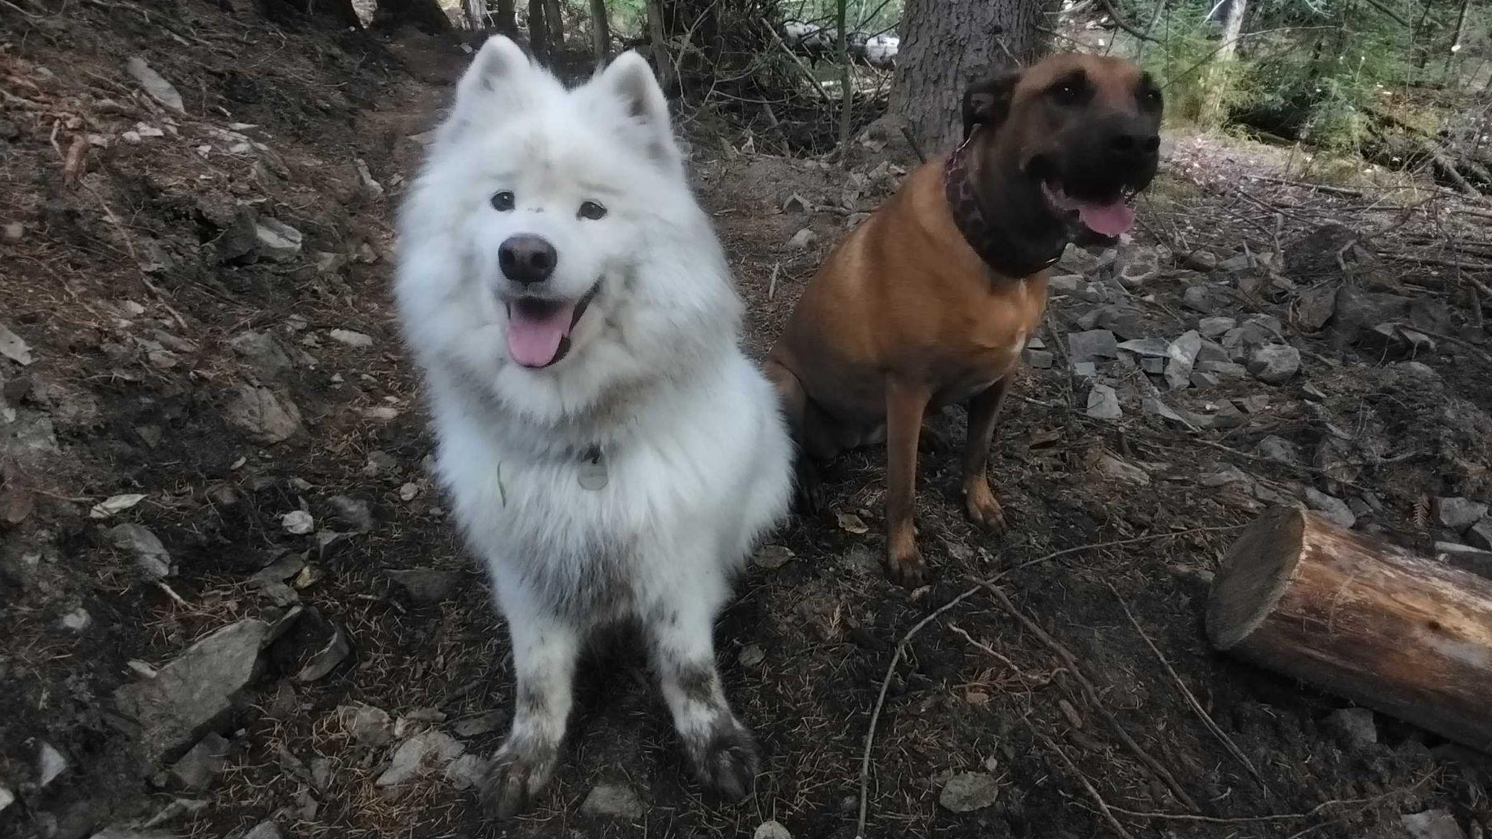
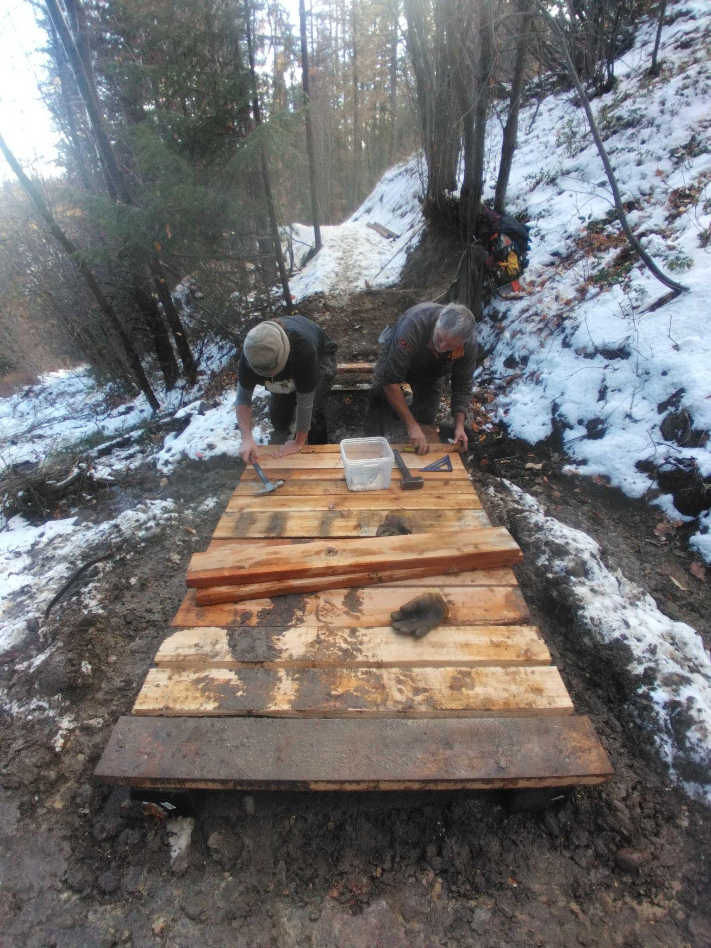
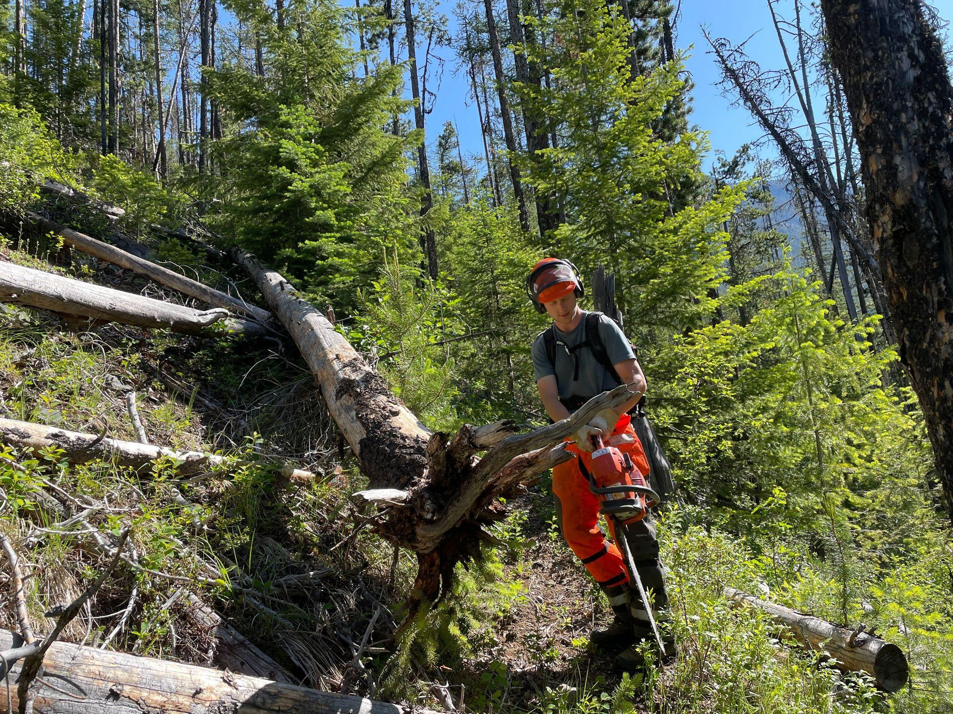
Our Amazing Summer & Fall Trail Crew’s
Justin - Calum - Cedar - Cory - Oliver - Tom

Slide 10
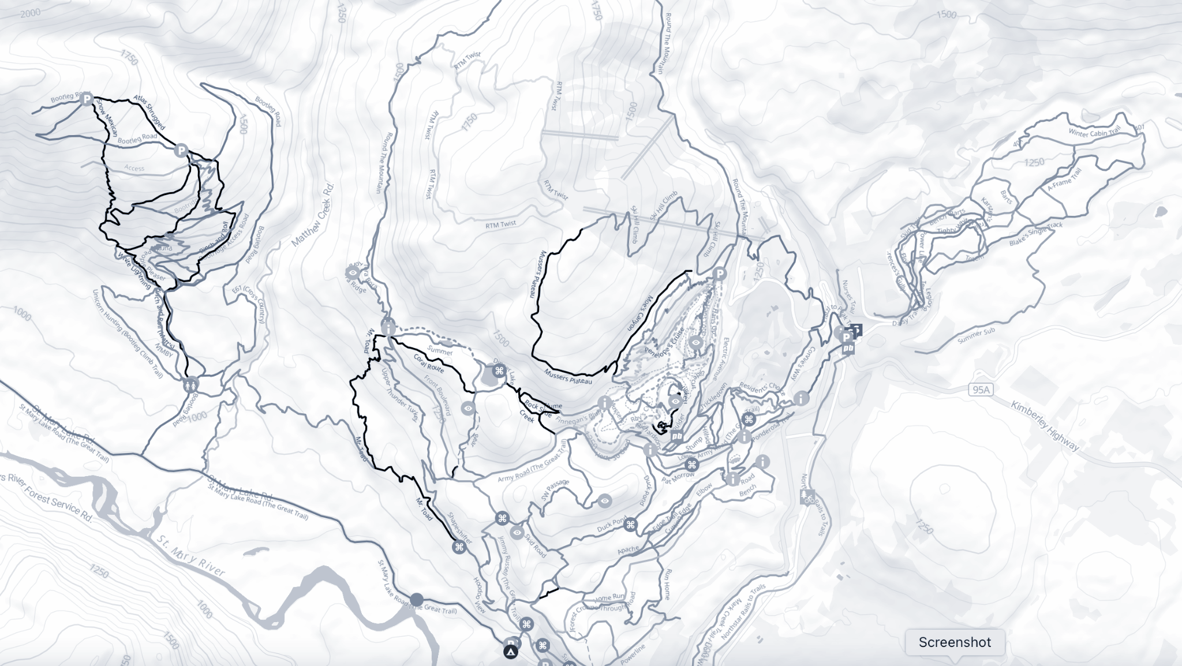
The Map

Slide 11
The Map
Trail Inventory
Winter Grooming

Slide 12
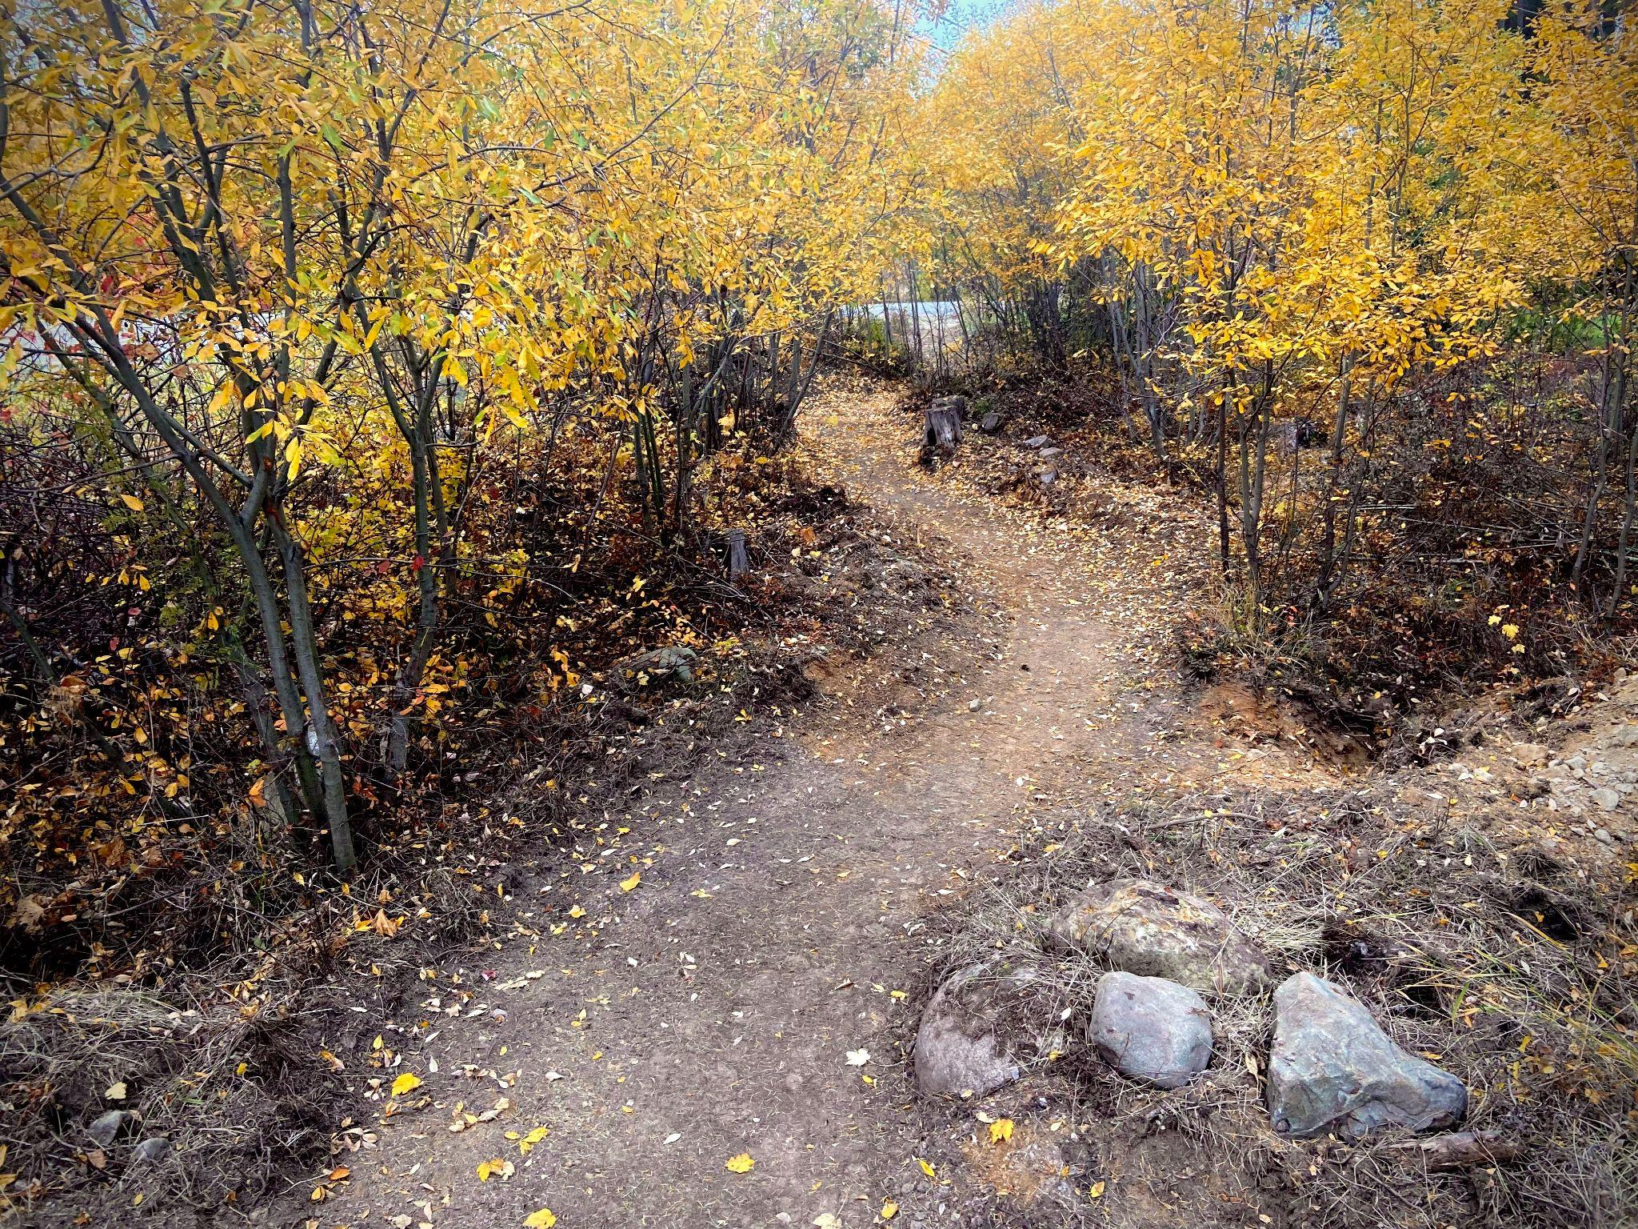
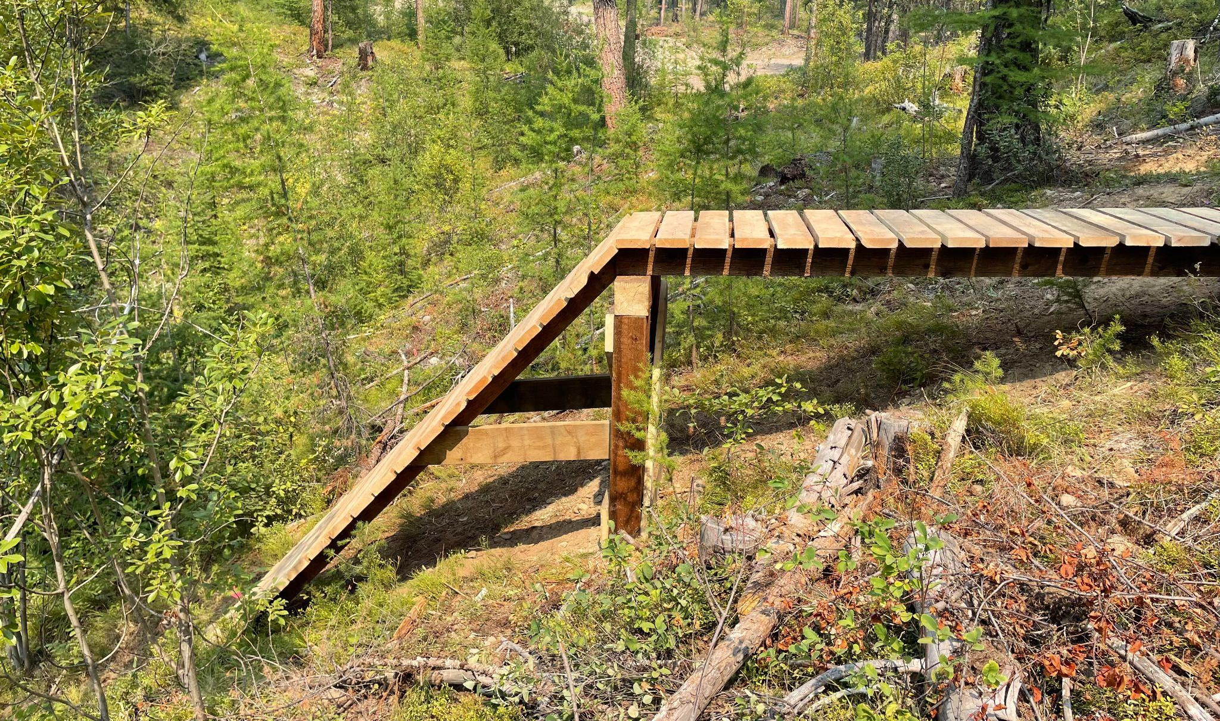
Electrify The Mountains
Installed signage (More to come)
Completed last three projects (Happy Hans, Trickle Charge, I Know What You Did…)

Slide 13
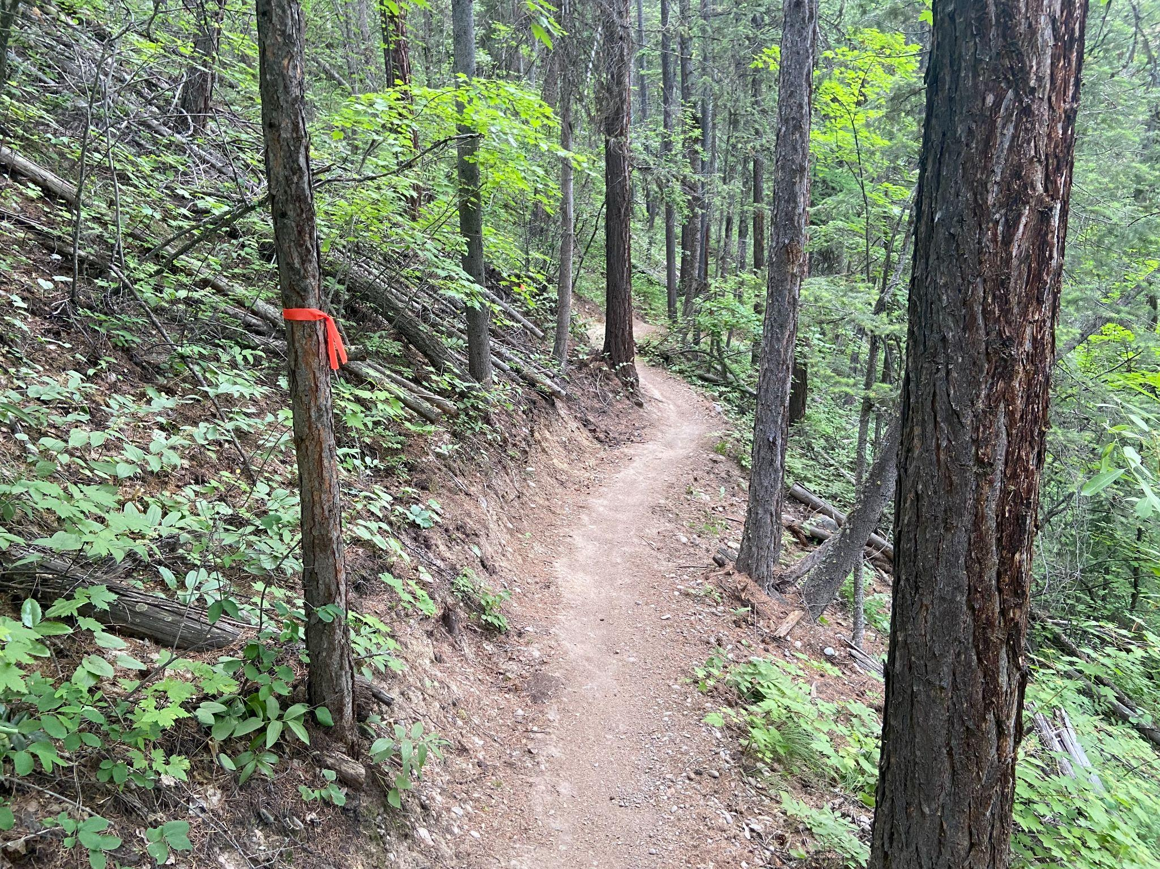
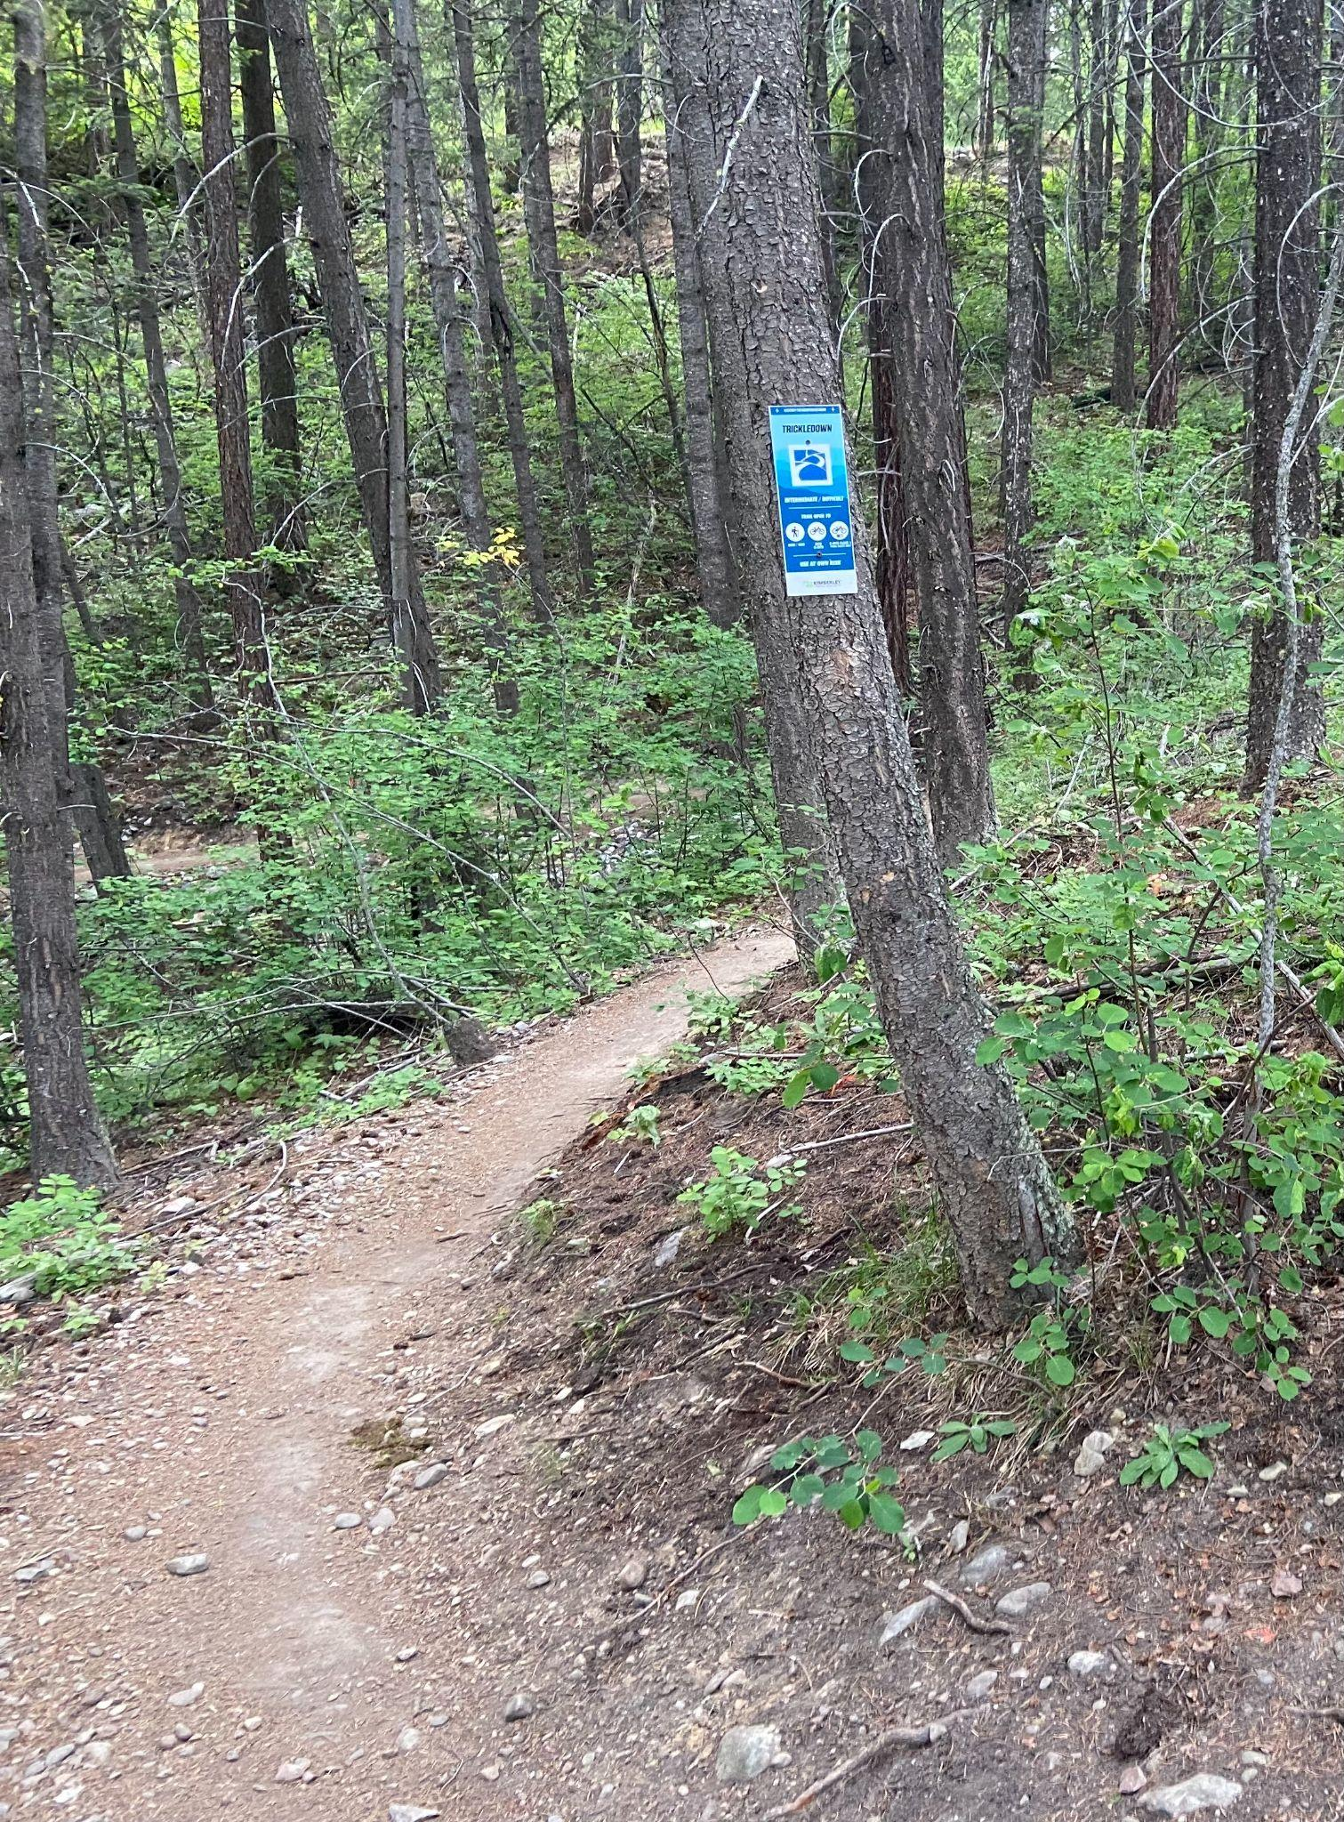
Trickledown Reroute
Create a more consistent corridor.
Thank you KTS Trail Crew, Volunteers and KNPS!

Slide 14
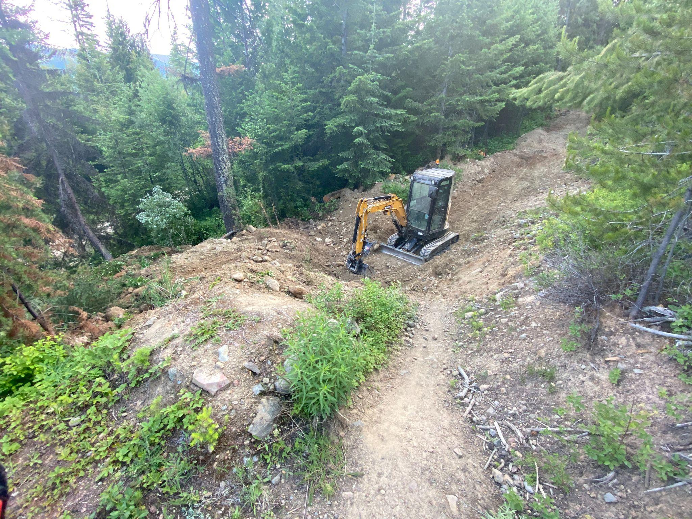
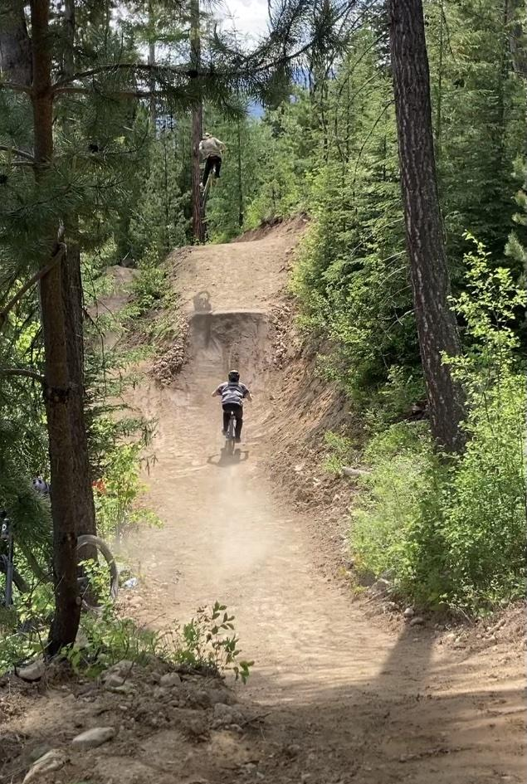
Bootleg Refurbish
Revitalize high traffic trails - White Lightning, SWATSW, Atlas Shrugged.
Thank you CBT & Munnin Trails!

Slide 15
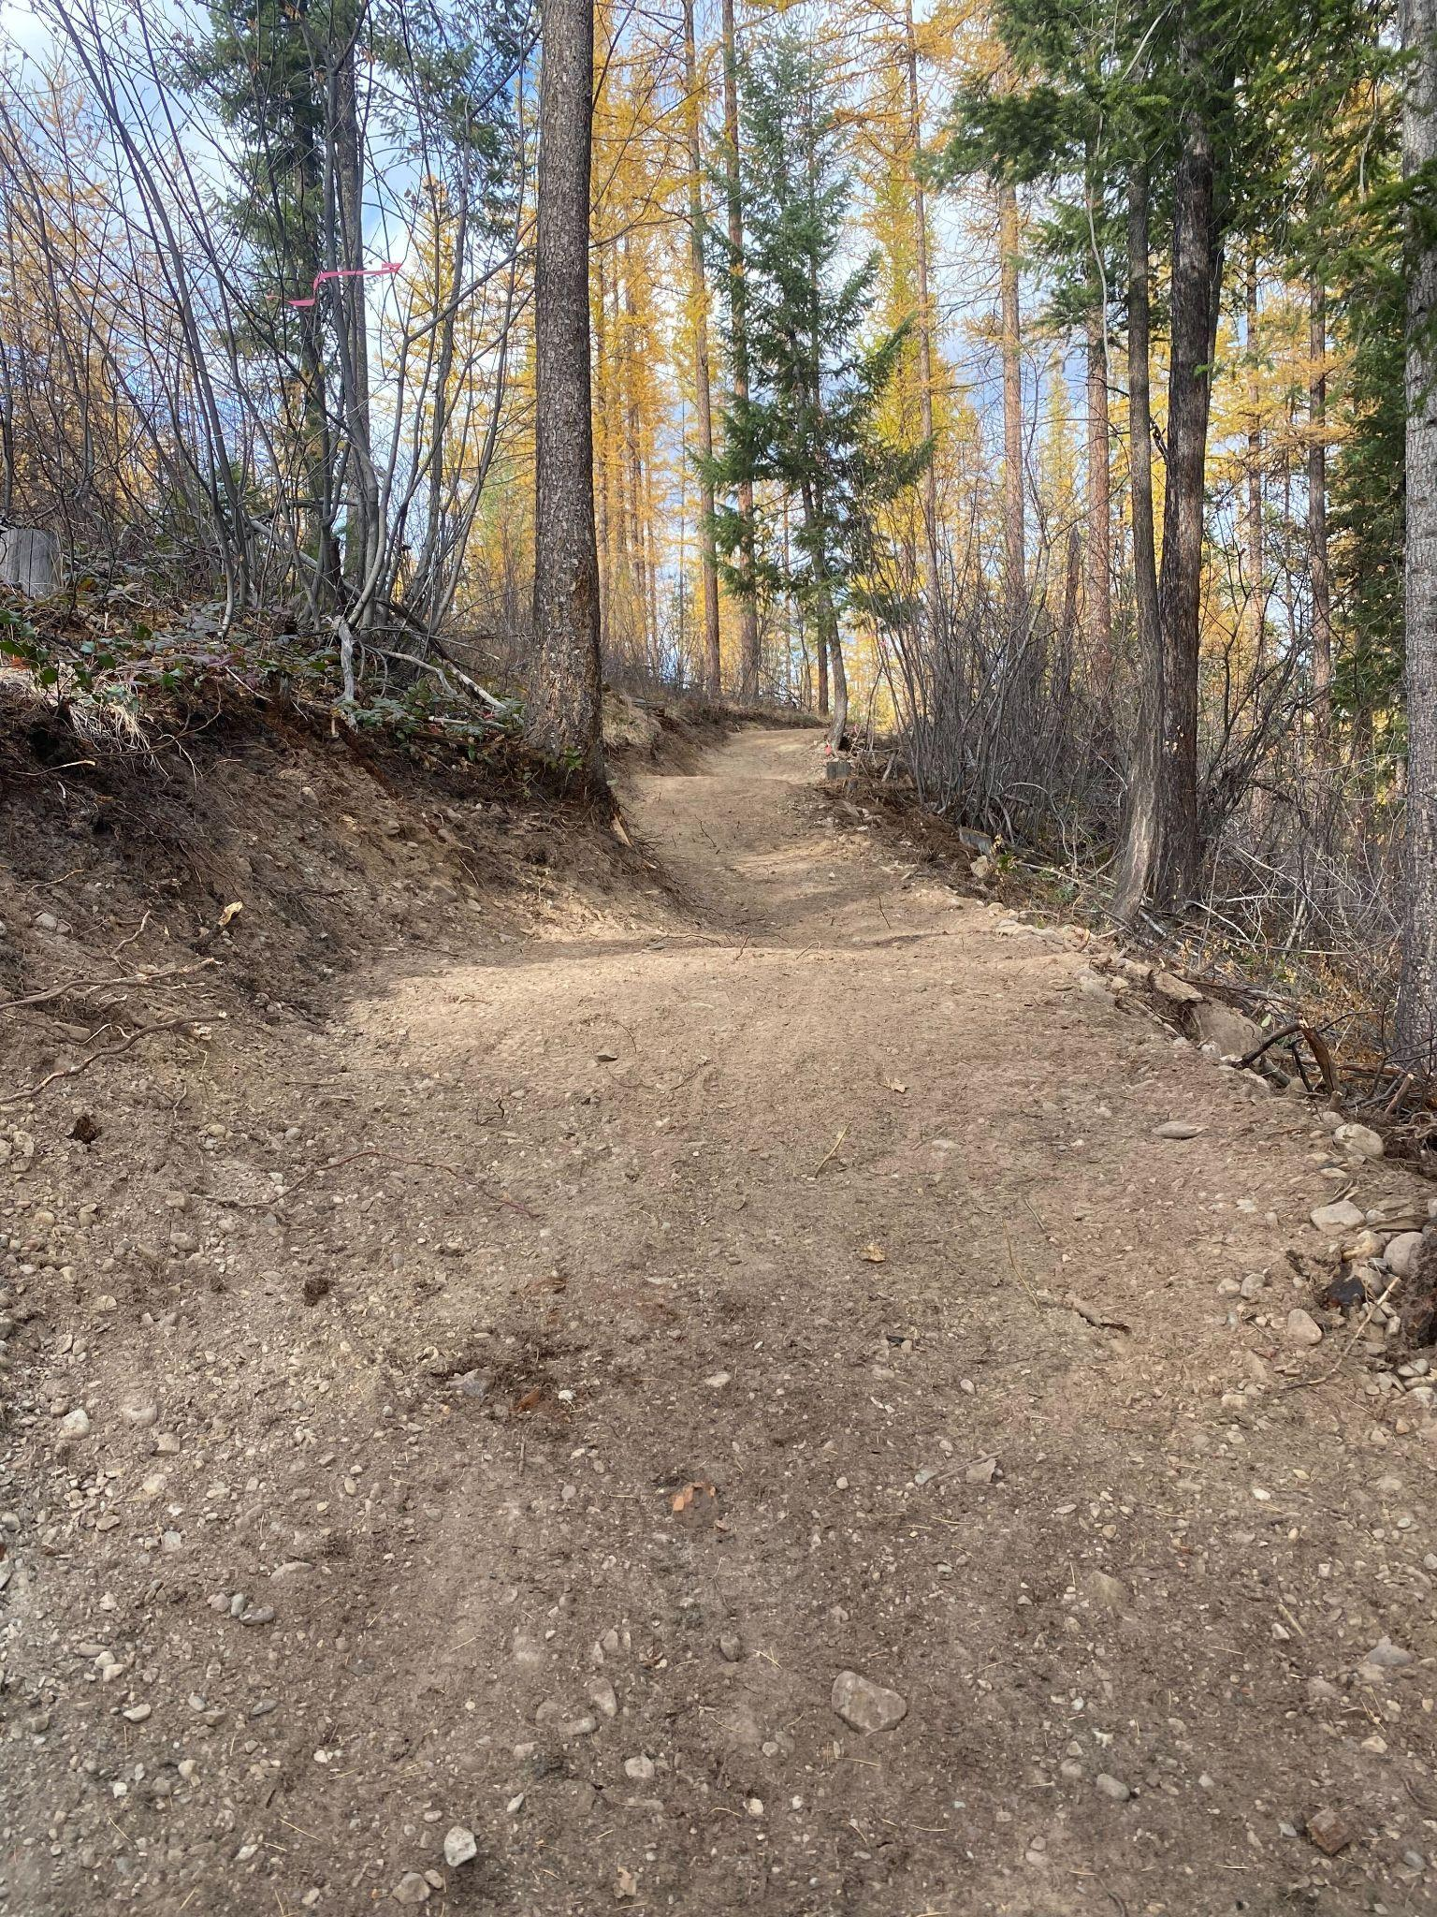
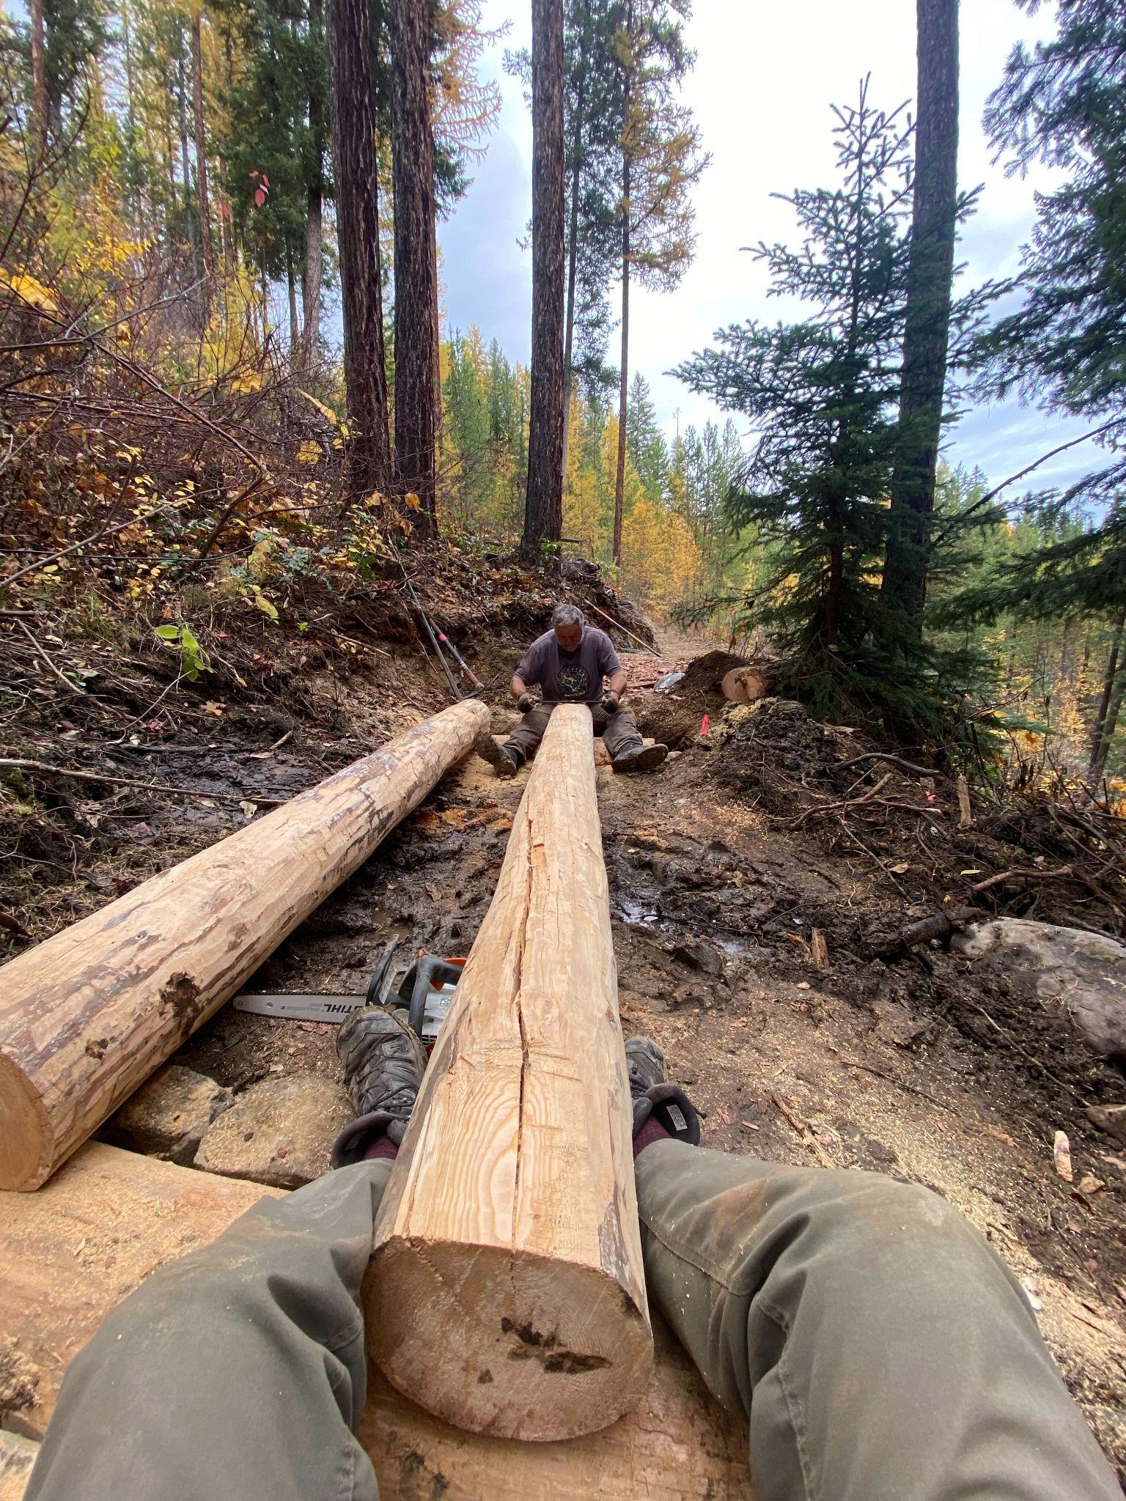
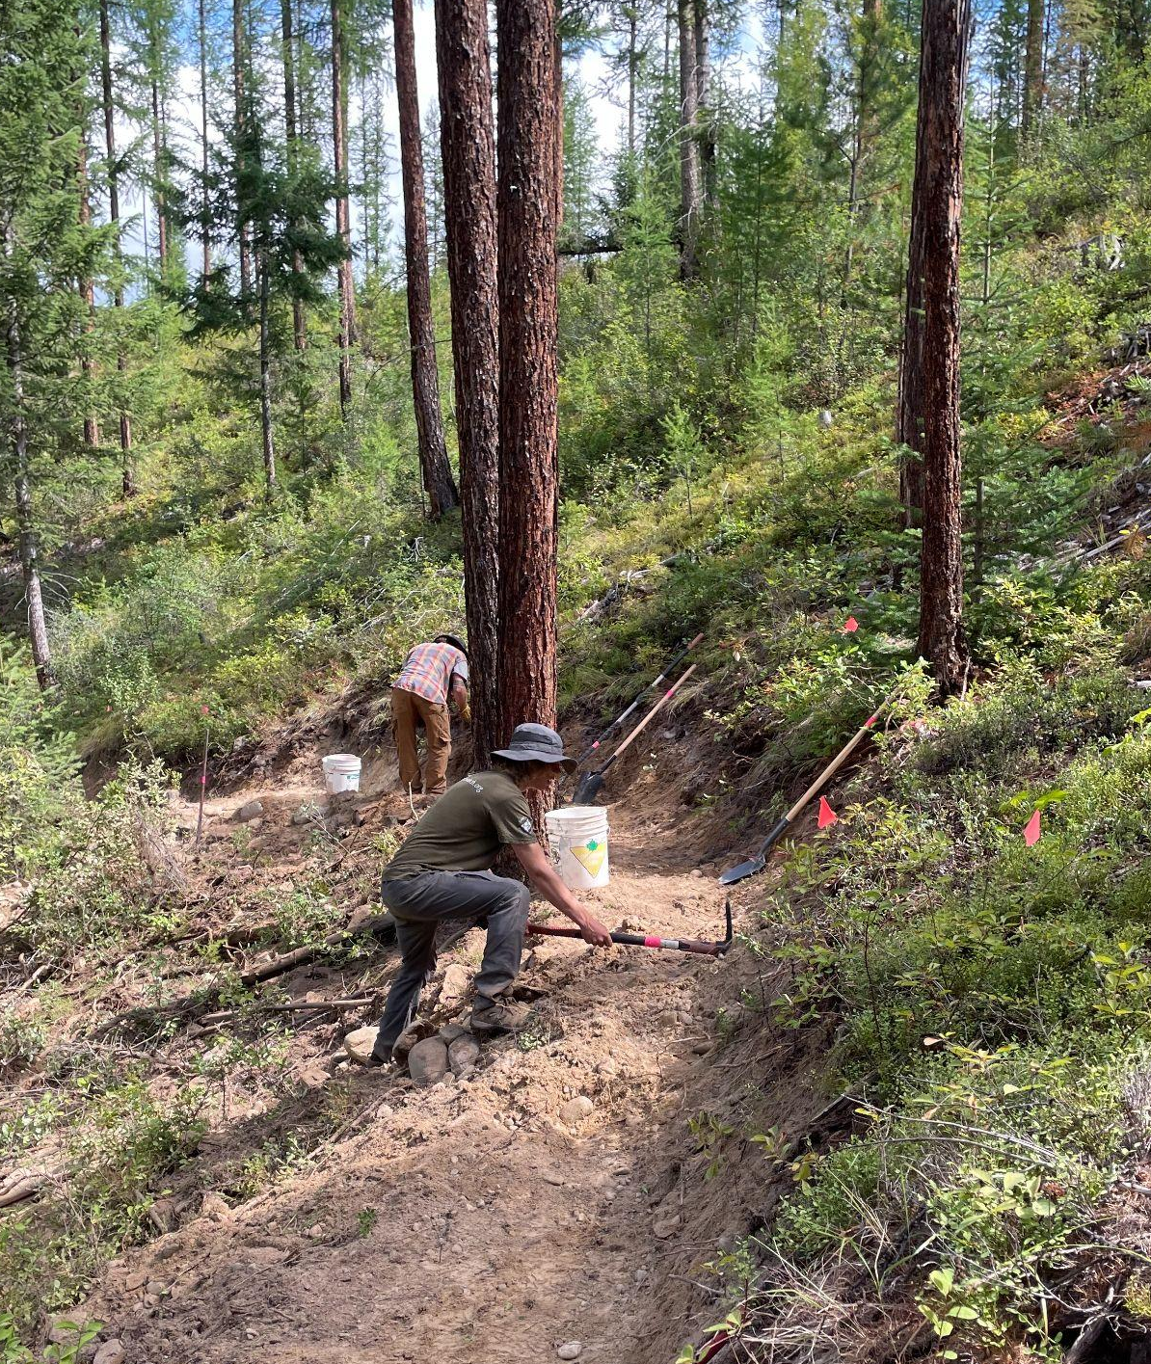
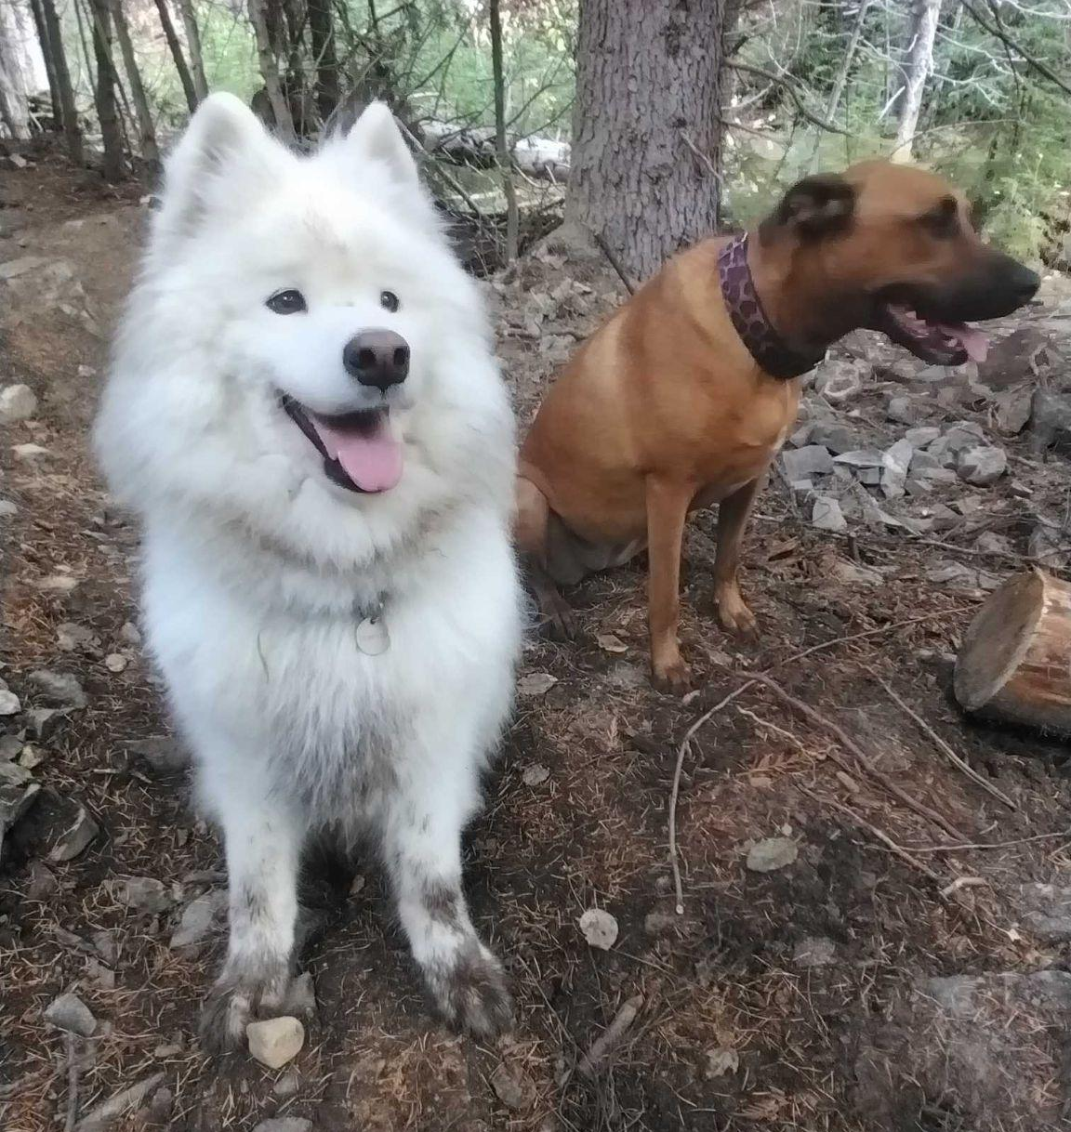
Lois Creek Powerline Reroute
Thank you Wildsight, FR Rentals, Volunteers, KTS Trail Crew, Munnin Trails, FOLC, City of Kimberley, REDI Grant, TC Energy, Fernie St Developments,

Slide 16
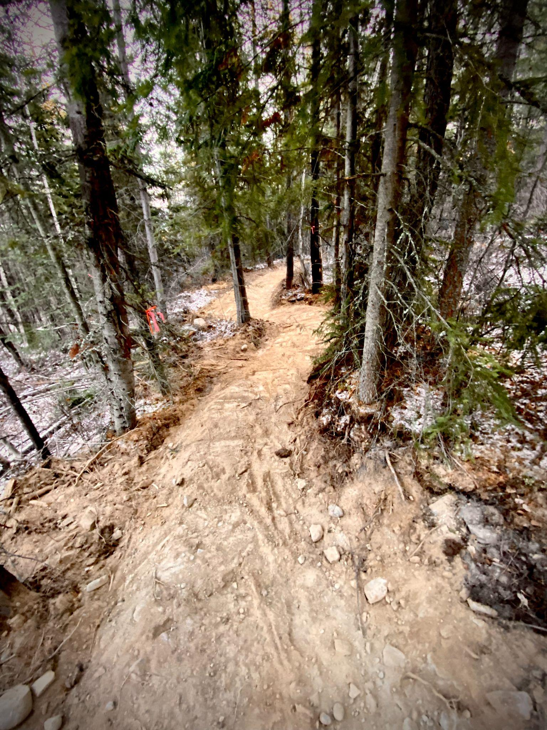
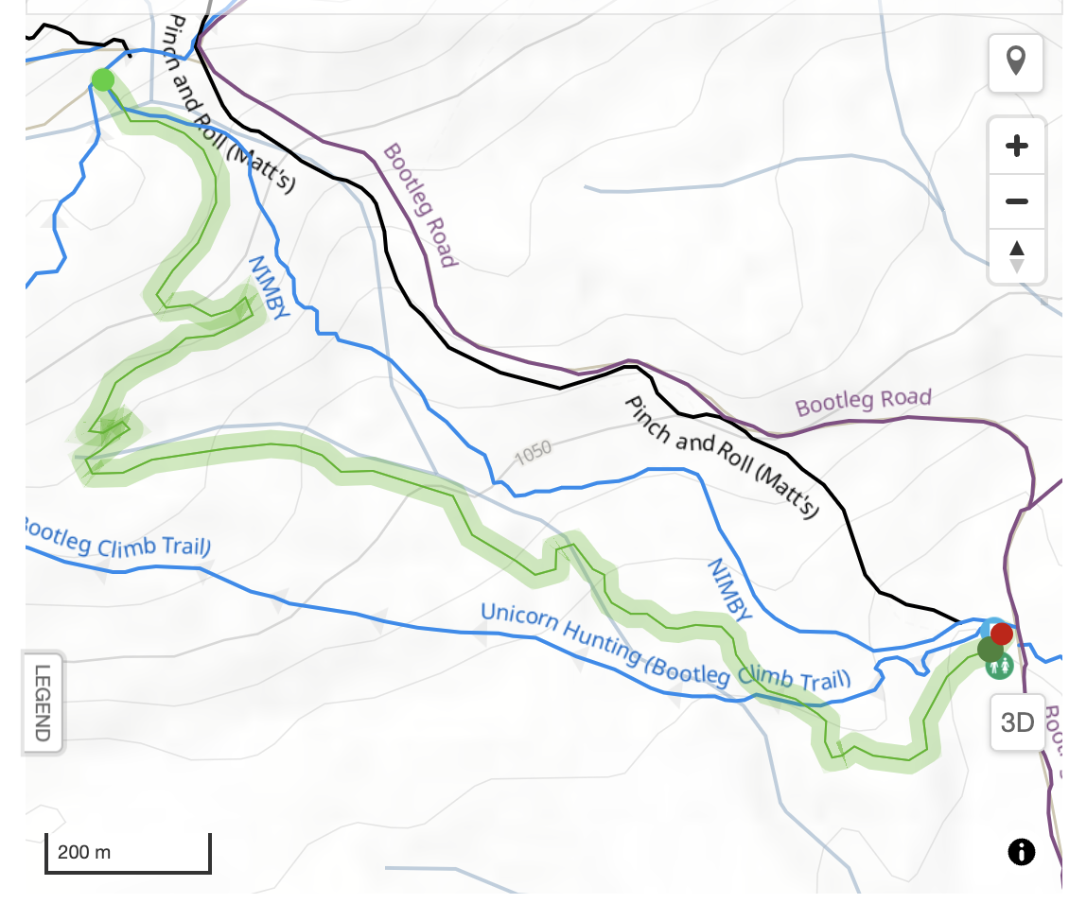
Bootleg Green Trail
Thank you Lifetime Outdoors! And RSTBC

Slide 17
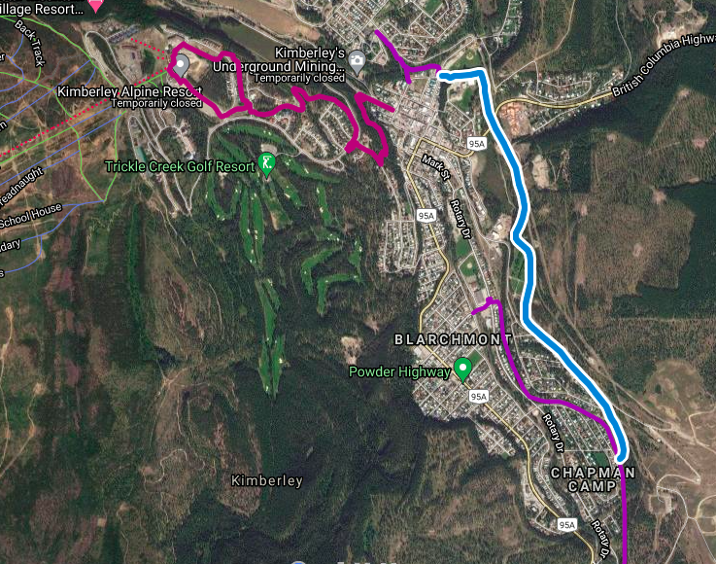
Paved Pathway Planning
Contracted McElhanney to provide preliminary plans
Working with TECK, CoK,on Feasibility
Thank you Active Transportation Grant and Trans Canada Trail

Slide 18
THE LIST - 2023
PROJECTS WE SUPPORTED
✅
Lois Creek Corridor and Wildfire Risk Reduction Clearing. Invasive Mitigation, Wildsight Florence’s Gully initiative support
Winter Grooming
Electrify the Mountains
Round the Mountain ‘23
Paved Pathway Planning initiative, Bootleg Refurbishment, Powerline Reroute, Trickledown Reroute,
Built in 2023
✅
Electrify The Mountains
Powerline reroute
Trickledown Reroute
Bootleg Refurbish
Bootleg Green Trail
TRAILS
WE FIXED
✅
Eimers Ridge, Trickledown, Romantic Ridge, Edge, Home Run, Apache, Mussers, Chute, Snow White, Unicorn Hunting, Pinch&Roll, Sneaking Cougar, Duck Pond, Atlas Shrugged, Pyramid Creek, RoundTheMountain,, Shapeshifter, Thunder Turkey

Slide 19
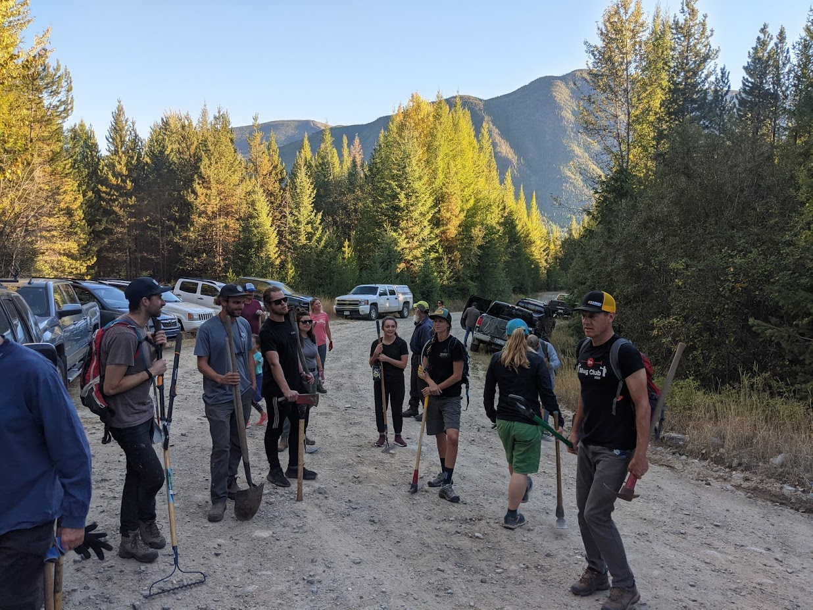
SOME NUMBERS FROM 2023
2467 hrs
800+ hrs
Trail Crew
Volunteer
1300
Trailforks reports
3km
New Trail
Awholelottatrails
Fixed and Refurbished

Slide 20
Lois Creek Update
Placeholder to remind us to invite FOLC to have a timeslot.

Slide 21
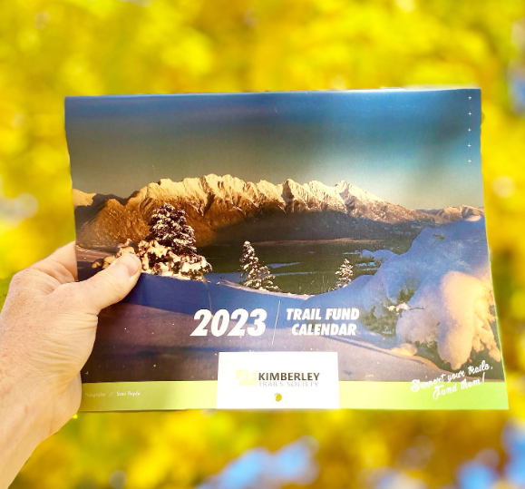
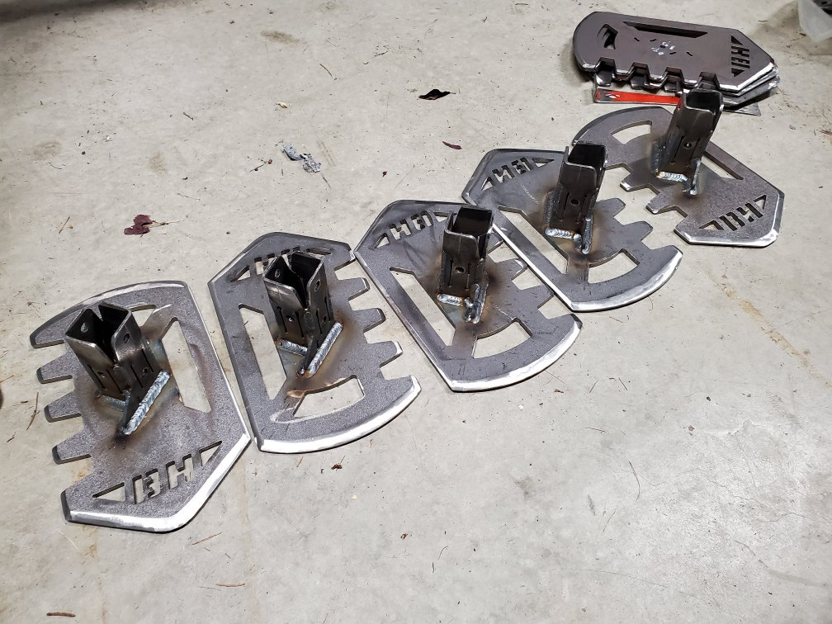
KTS Fundraising Initiatives 2023
$2,462
$17,561
$5,175
$6,371
$7,227
$910
$1,297

Slide 22
Kimberley Bike Park Revitalization Project
Brought to you by the Kimberley Bike Park Committee
OCTOBER 2023

Slide 23
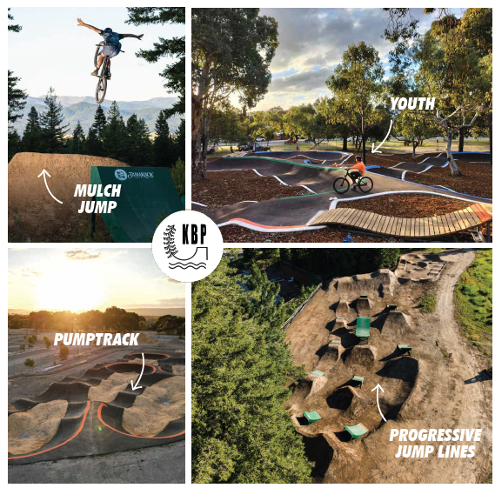
Our vision
Notes:
The time line reflects the deadlines set out by CBT and Tourism BC. We are in the process of working on the RFPs for both the dirt jumps and Pump Track in the hopes to start both builds this coming summer.

Slide 24
Project Timeline Overview - three phases
Initiation
Bike Park sub committee
Planning
Grant Applications
Phase 1
Dirt Jump Built
Phase 3
Green Space
2023
2025
2022
2024
2026
Planning
SIte Preparation
Partnerships & Collaborations
Phase 2
Pump track built
Final
Grand opening
Notes:
The time line reflects the deadlines set out by CBT and Tourism BC. We are in the process of working on the RFPs for both the dirt jumps and Pump Track in the hopes to start both builds this coming summer.

Slide 25
Project Timeline Overview - three phases
Initiation
Bike Park sub committee
Planning
Grant Applications
Phase 1
Dirt Jump Built
Phase 3
Green Space
2023
2025
2022
2024
2026
Planning
SIte Preparation
Partnerships & Collaborations
Phase 2
Pump track built
Notes:
The time line reflects the deadlines set out by CBT and Tourism BC. We are in the process of working on the RFPs for both the dirt jumps and Pump Track in the hopes to start both builds this coming summer.

Slide 26
Project Timeline Overview - three phases
Initiation
Bike Park sub committee
Planning
Grant Applications
Phase 1
Dirt Jump Built
Phase 3
Green Space
2023
2025
2022
2024
2026
Planning
SIte Preparation
Partnerships & Collaborations
Phase 2
Pump track built
Final
Grand opening
Notes:
The time line reflects the deadlines set out by CBT and Tourism BC. We are in the process of working on the RFPs for both the dirt jumps and Pump Track in the hopes to start both builds this coming summer.

Slide 27
2022
First year of the Project
Partnership with City of Kimberley (CoK) parks and facility
Applied to the CBT Outdoor Active Recreation Grant
Movie Night
Fundraising
Shoulder Season 1
Winter 2021
Spring 2022
Summer 2022
Winter 2022
Created a Bike Park sub-committee under KTS
Bike Park Survey
April 2022
Links to Survey Summary
Concept Plan drafted

Slide 28
2023
first grants awarded & initiation of phase 1
Site prep. with the City of Kimberley and BC Wildfire Service
Contractors leveled the mound adjacent to the Skate Park and regraded the area
Application to the Destination Development Fund for Pump Track
Shoulder Season 2 Movie Night
Shoulder Season 3
Movie Night
Winter 23
Spring 2023
Summer 2023
Fall 23
Grant applications
$64,000 awarded
to City of
Kimberley for
Phase 1 - Dirt Jumps
Really big, big day of volunteers to clean up and haul away debris
Planning &
Meetings
Phase 1 Dirt Jumps RFP finalized with CoK
KTS awarded with BC Tourism Destination Development Grant $350,000 for Pump Track
Notes:
“After a busy Spring of site preparation the Bike Park Committee worked hard on a few major items behind the scenes over the summer. We met as a group to brainstorm ideas, go over draft plans and continued to liaise with the City of KImberley to prepare our RFP for the design and construction of the Phase 1, Rebuilding the Dirt Jumps.
During this time, we were asked by the Ministry of Tourism, Arts and Culture and Sport to apply for the second stage in the Destination Development Grant. This funding is geared towards projects that support the development and rejuvenation of tourism infrastructure, assets and experiences to build vibrant communities. Much to our delight we were recently notified that we were awarded $350,000 for the Design and Construction of a Paved Pump Track adjacent to the Kimberley Skate Park! This is a major contribution that propels the Kimberley Bike Park Revitalization Project into high gear next year! Stay tuned throughout the Winter for updates on timelines, contractors and information on how other communities in British Columbia are developing their Bike Parks.”

Slide 29
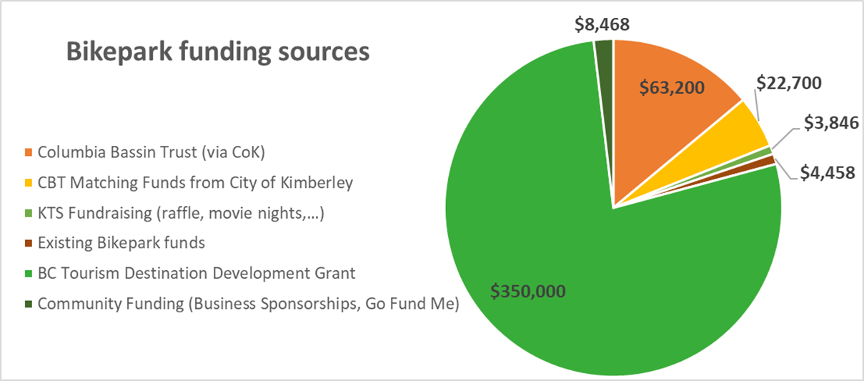
Funding

Slide 30
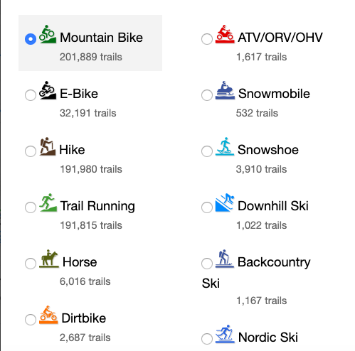
TRAILFORKS

Slide 31
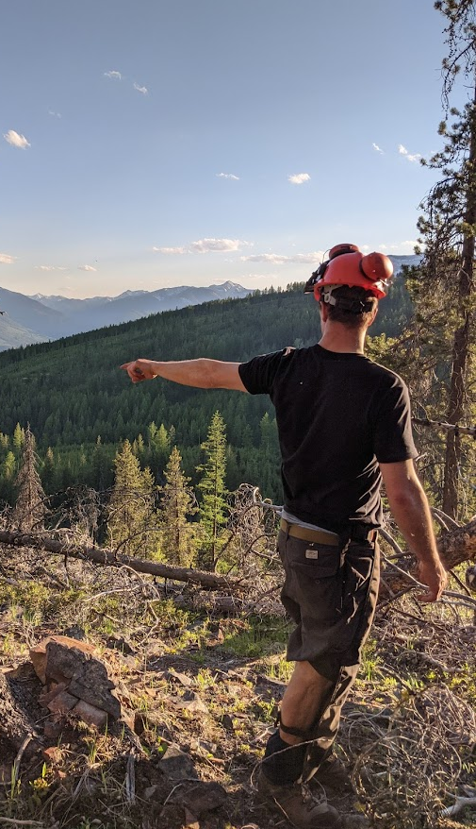
THE FUTURE
2024
Trail Crew 2024
Winter Grooming
Bootleg Green Trail
Round the Mountain 24
Bike Park Revitalization
Paved Pathway Plan
Volunteer Trail Nights

Slide 32
2023 KTS INCOME STATEMENT
Summary 12 months: 2022-11-01 to 2023-10-31
Income: 2023 2022
City of Kimberley 30,663 24,448
Columbia Basin Trust & TCT 65,752 66,430
Government grants 60,654 20,985
Trail Sponsorships 29,750 29,955
Memberships & Donations 20,960 5,213
Income from Events & Fundraising 82,389 15,204
---------- -----------
Total income 290,168 162,236
Expenses:
Payroll 92,410 80,018
Cost of trail building 73,107 30,916
Insurance (including events): 5,196 3,491
Fundraising expenses 22,598 3,269
Other expenses 7,179 15,087
---------- -----------
Total expenses 200,492 132,783
Net income (loss) 89,957 29,453

Slide 33
2023 KTS BALANCE SHEET
Highlights as at Oct 31, 2023::
2023 2022
General funds: $ 47,477 $ 24,162
Trails GM & trail crew fund: 29,642 27,464
Round the Mountain fund: 7,561 -
Trail development funds
Paved Pathway Extension: 43,204 -
Bike Park : 6,005 -
Winter Grooming: 3,513 -
FOLC 2,031 2,210
Other : 987 1,251
---------- ----------
Total funds in bank: 140,423 55,089
Accounts receivable 6,693 2,352
---------- ----------
Current Assets $ 147,116 $ 57,441

Slide 34
GET INVOLVED!
Become a KTS Lifetime Member - Visit KimberleyTrails.org
Join a KTS Subcommittee - Chat to the committee heads this evening!
Get Your Annual Trail Pass - Visit KimberleyTrails.org, $40 goes to maintenance
Attend Monthly meetings - Second Tuesday of every month 7 pm (Mckim School through winter, Kimberley Nordic Centre through rest of the year)
Donate Trail Karma via Trailforks App (App store, Android store)
Visit our Website at www.kimberleytrails.org
Follow us on Facebook, Instagram at @kimberleytrails
Tell a Friend.
Trails do not maintain themselves, we really need your help.
Notes:
Brett to speak?

Slide 35
BECOME A MEMBER
Communications
Website: kimberleytrails.org
Monthly updates sent to lifetime members, trail crew volunteers and other trail users in our contact list
Facebook, Instagram (#kimberleytrails), and community calendar
Lifetime KTS Membership
Just $20 for the rest of your life! KimberleyTrails.org
Helps pay for trail maintenance and KTS administration
914 members in 2023, looking for 100+ more for 2024
Membership numbers give us credibility: PLEASE JOIN NOW!

Slide 36
2023 TRAIL PASS
NEW trail pass options for families, youths and seniors.
NEW we introduced a trail usage fee where most people participating in organised events / groups to hold a trail pass.
Option to purchase or earn you trail pass.
Please collect your trail pass stickers to show your support!
Notes:
Over $700 collected in Karma in 2017.

Slide 37
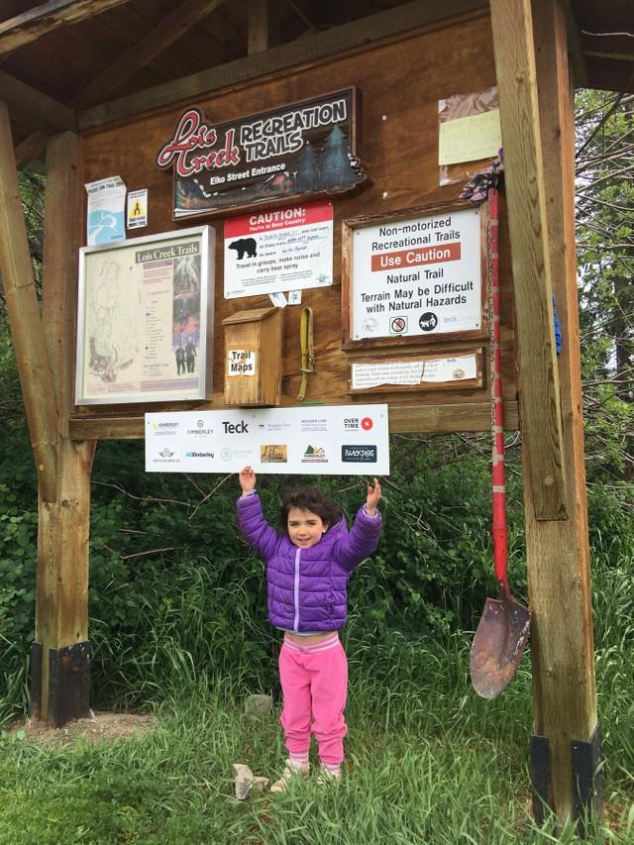
BECOME A SPONSOR
PLATINUM SPONSOR - $5,000 > Supports 50km of trail
GOLD SPONSOR - $2,500 > Supports 20km of trail
SILVER SPONSOR - $1,000 > Supports 10km of trail
BRONZE SPONSOR - $500 > Supports 5km of trail
COMMUNITY CONTRIBUTOR - $100+ > Supports 1km+ of trail
Benefits:
Logo Sponsor in KTS Trail Calendar
Event sponsorship exposure (Trail Night, RTM)
Logo signage at Trailhead
Business story + highlight on social media
Trailforks logo and mention (Platinum & Gold )
Newsletter and Website Logo

Slide 38
PROJECTS MADE POSSIBLE
WITH SUPPORT FROM SPONSORS:
Supporting Partners
PLATINUM SPONSORS = $5,000 = 50 km of trails

Slide 39
PROJECTS MADE POSSIBLE
WITH SUPPORT FROM SPONSORS:
GOLD SPONSORS - $2,500 = 25 km of Trails
SILVER SPONSORS - $1,000 = 10 km of Trails
BRONZE SPONSORS - $500 = 5 km of Trails

Slide 40
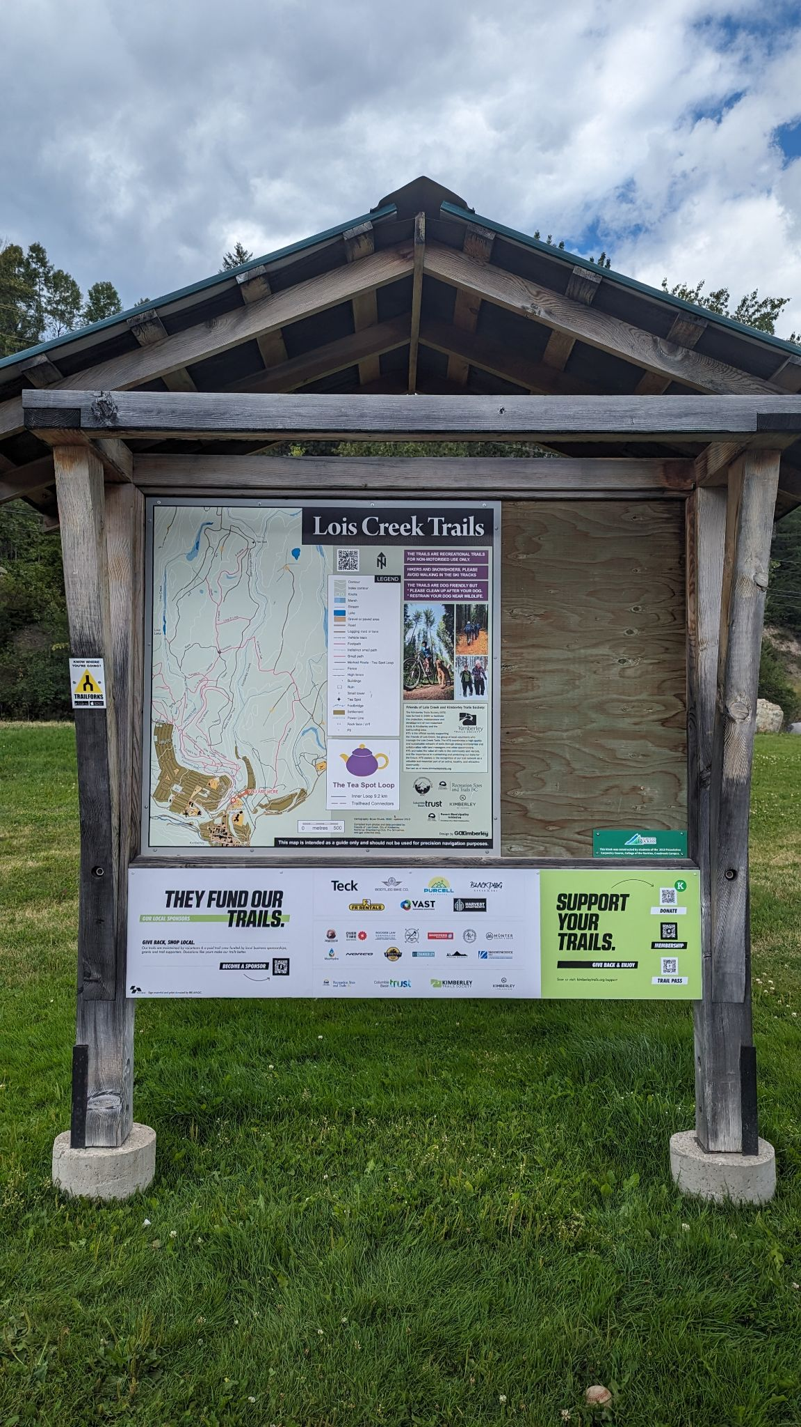
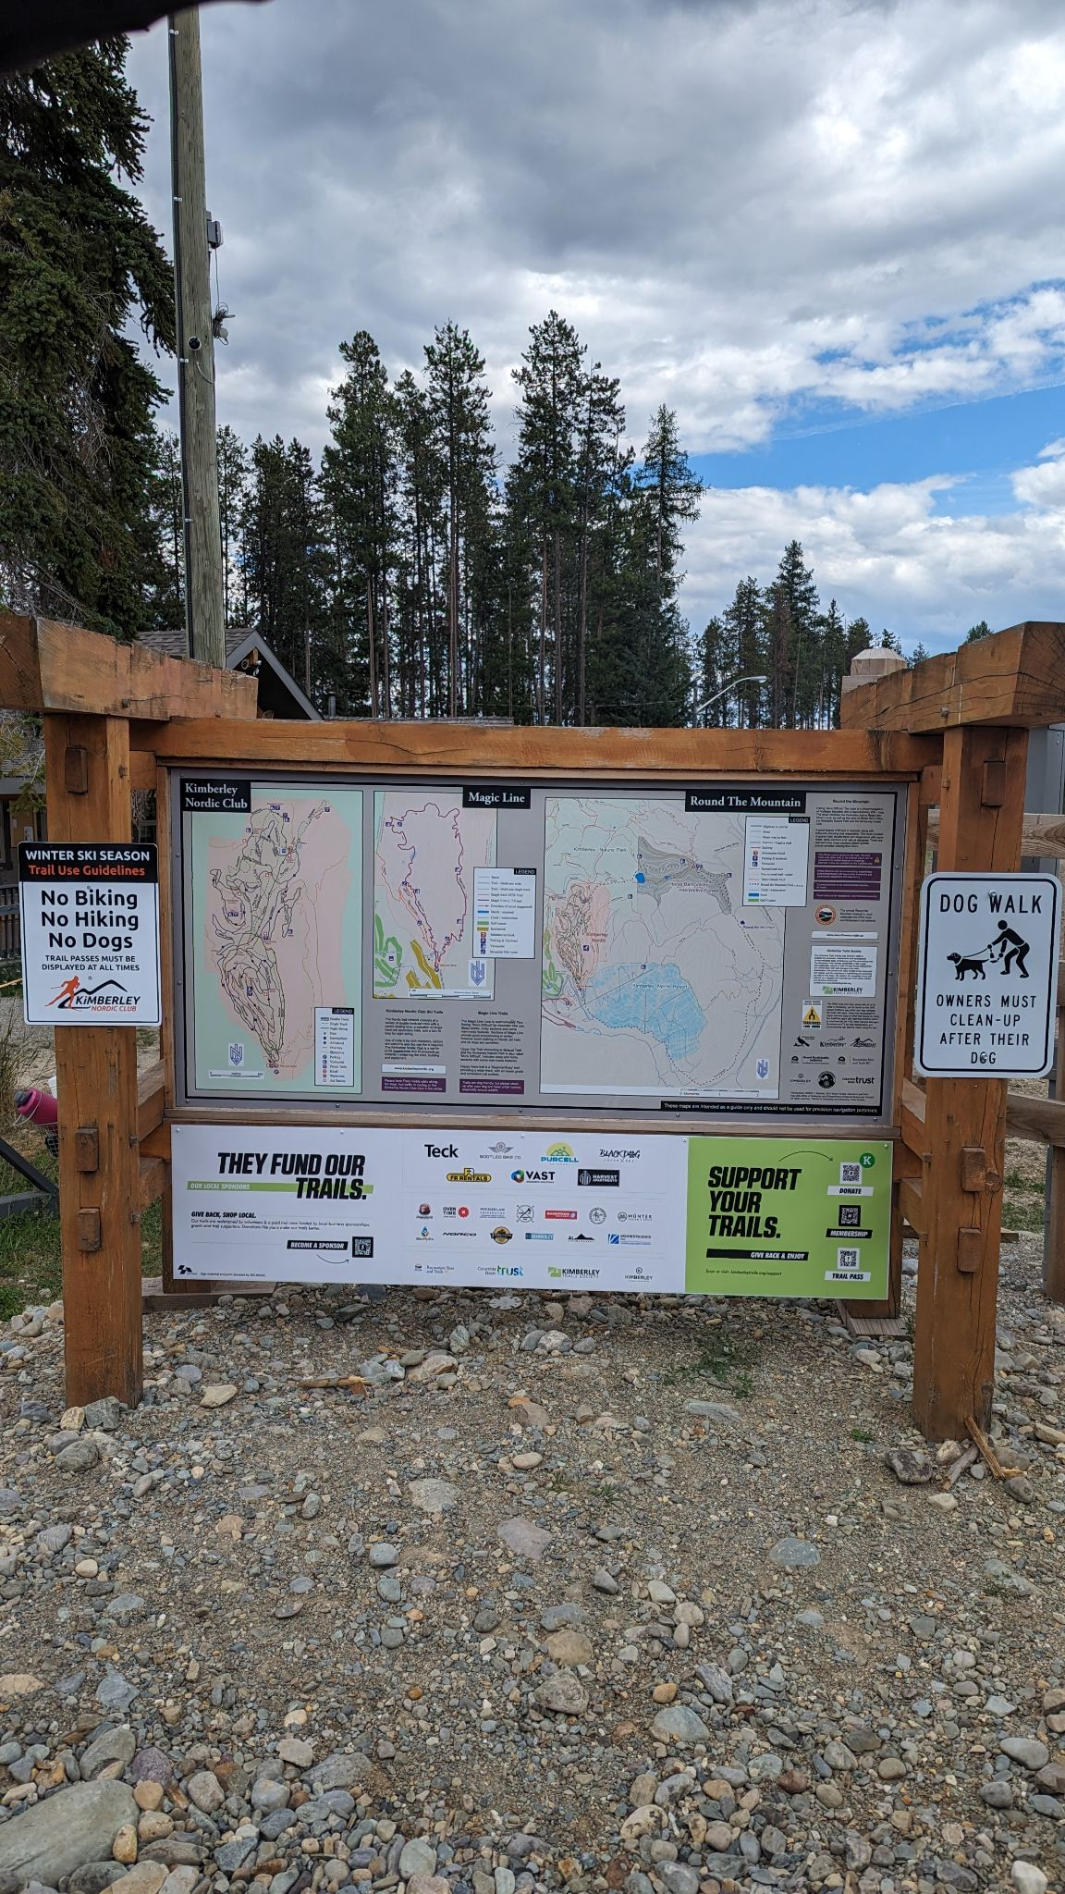
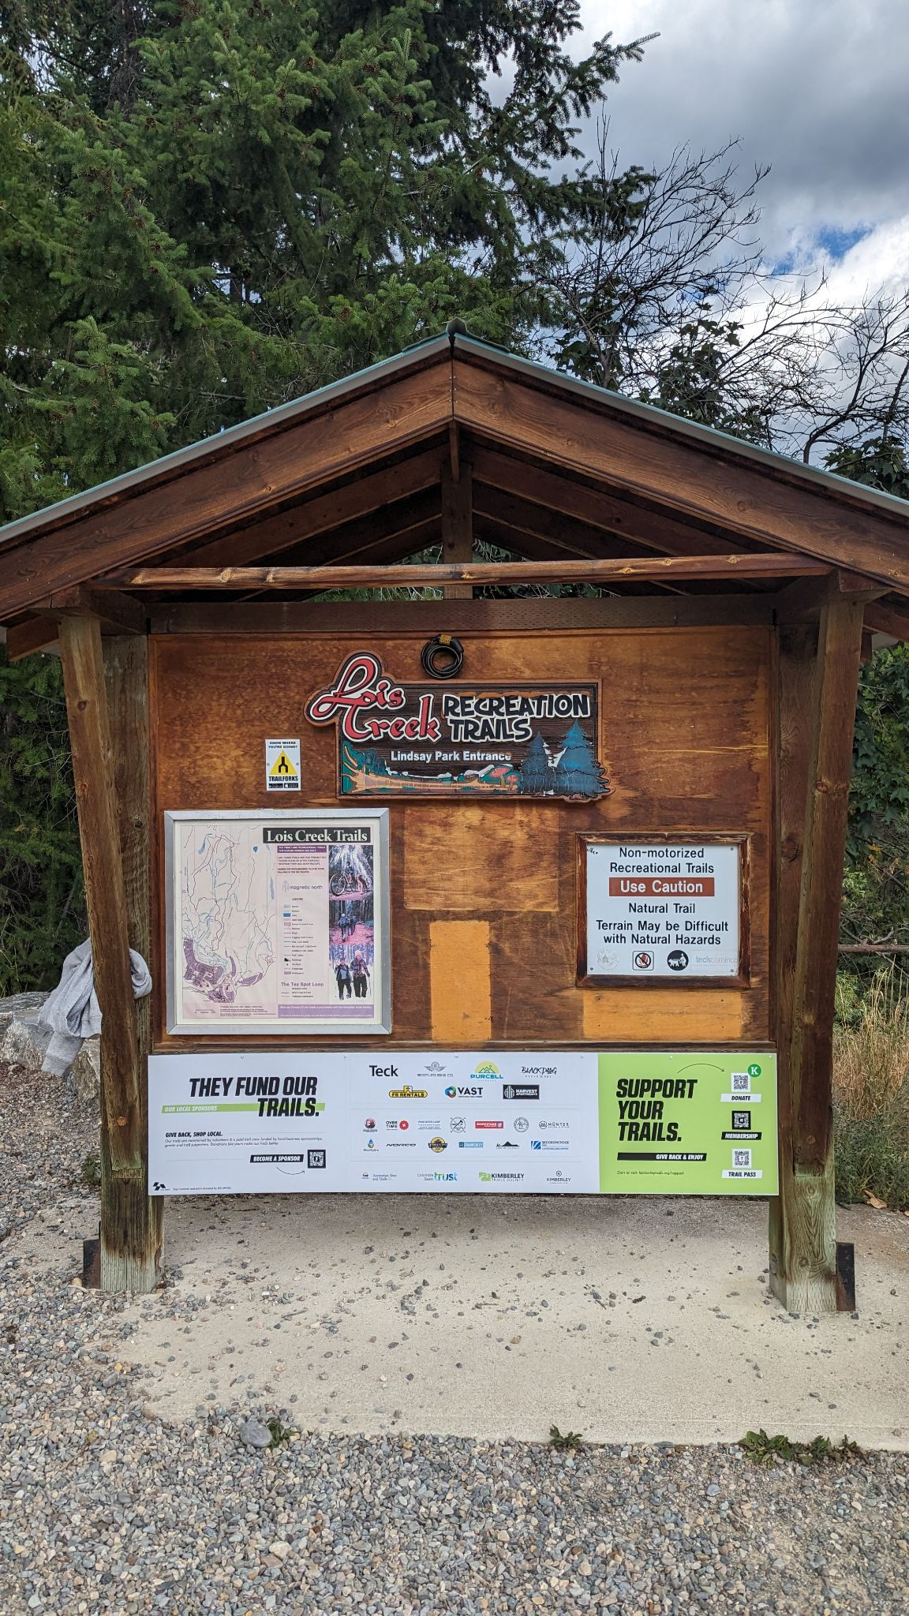
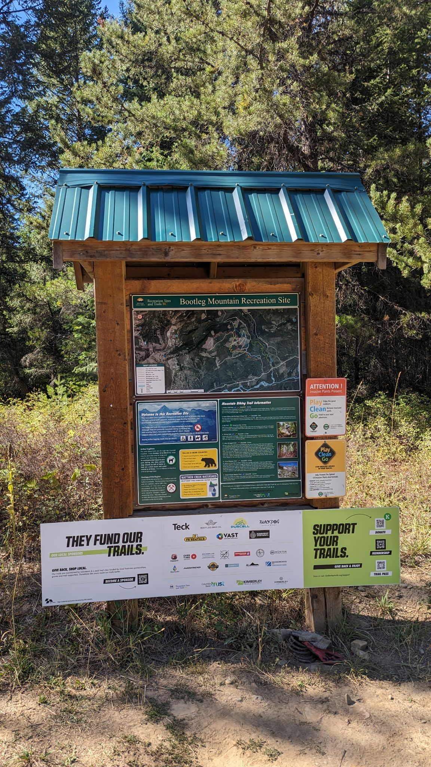
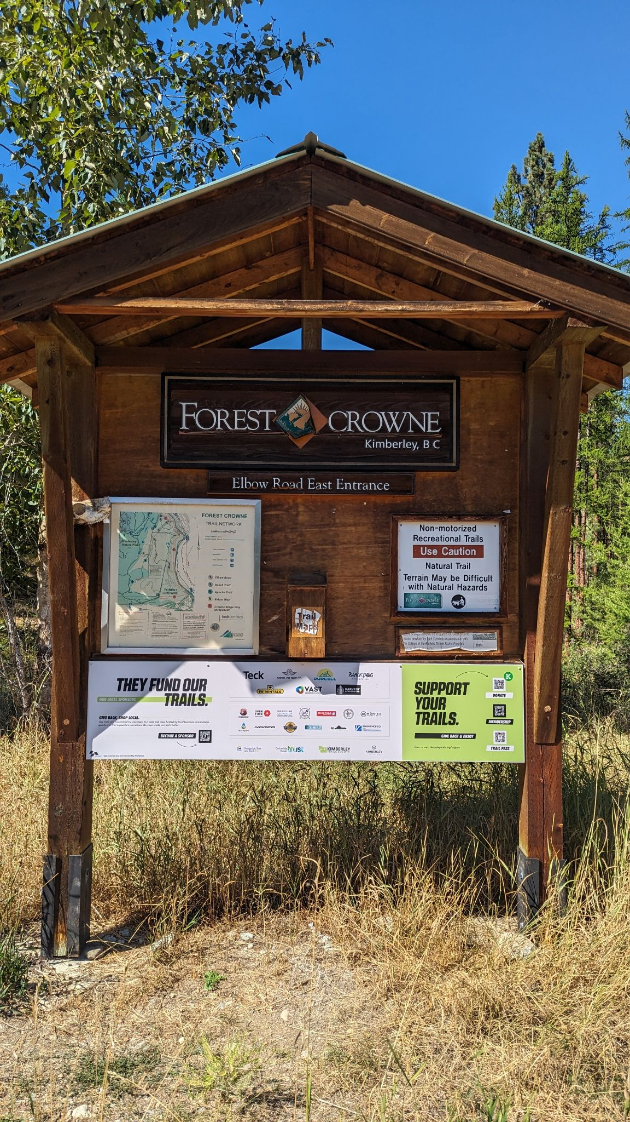
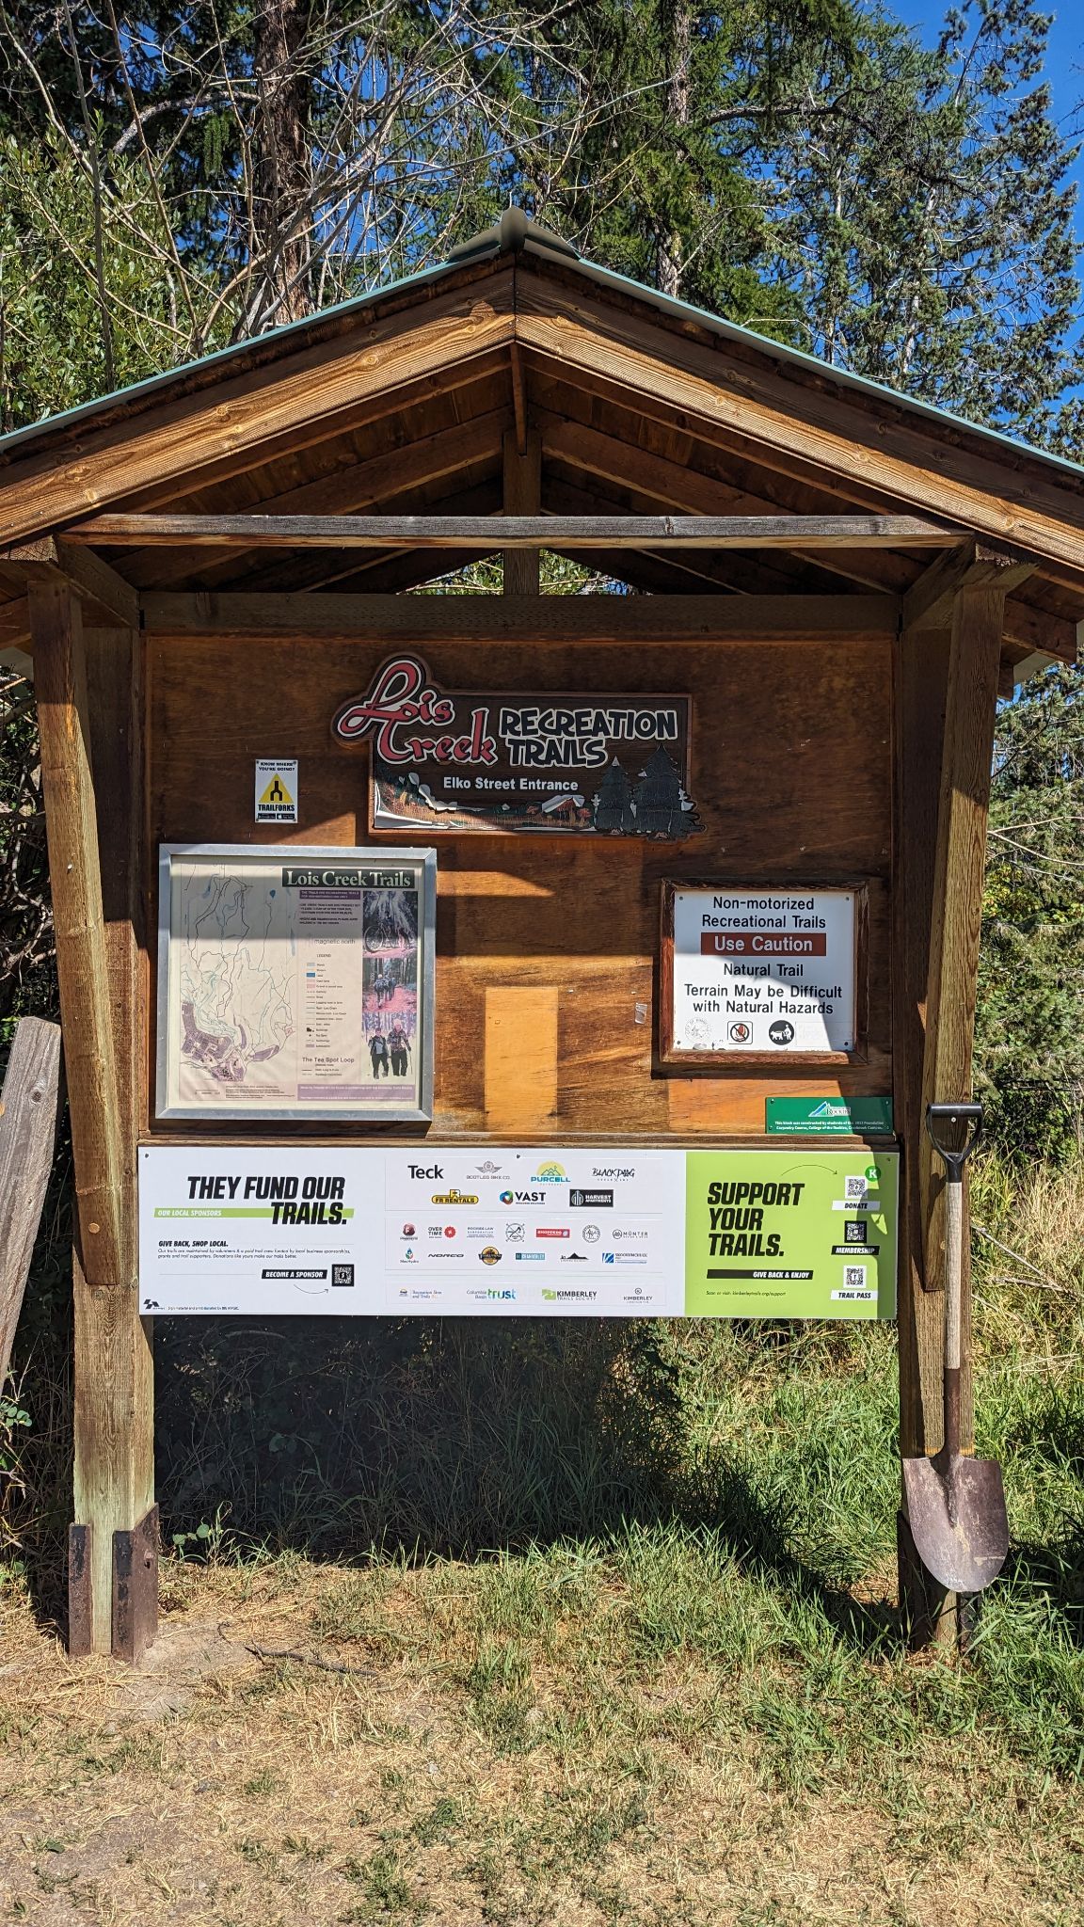
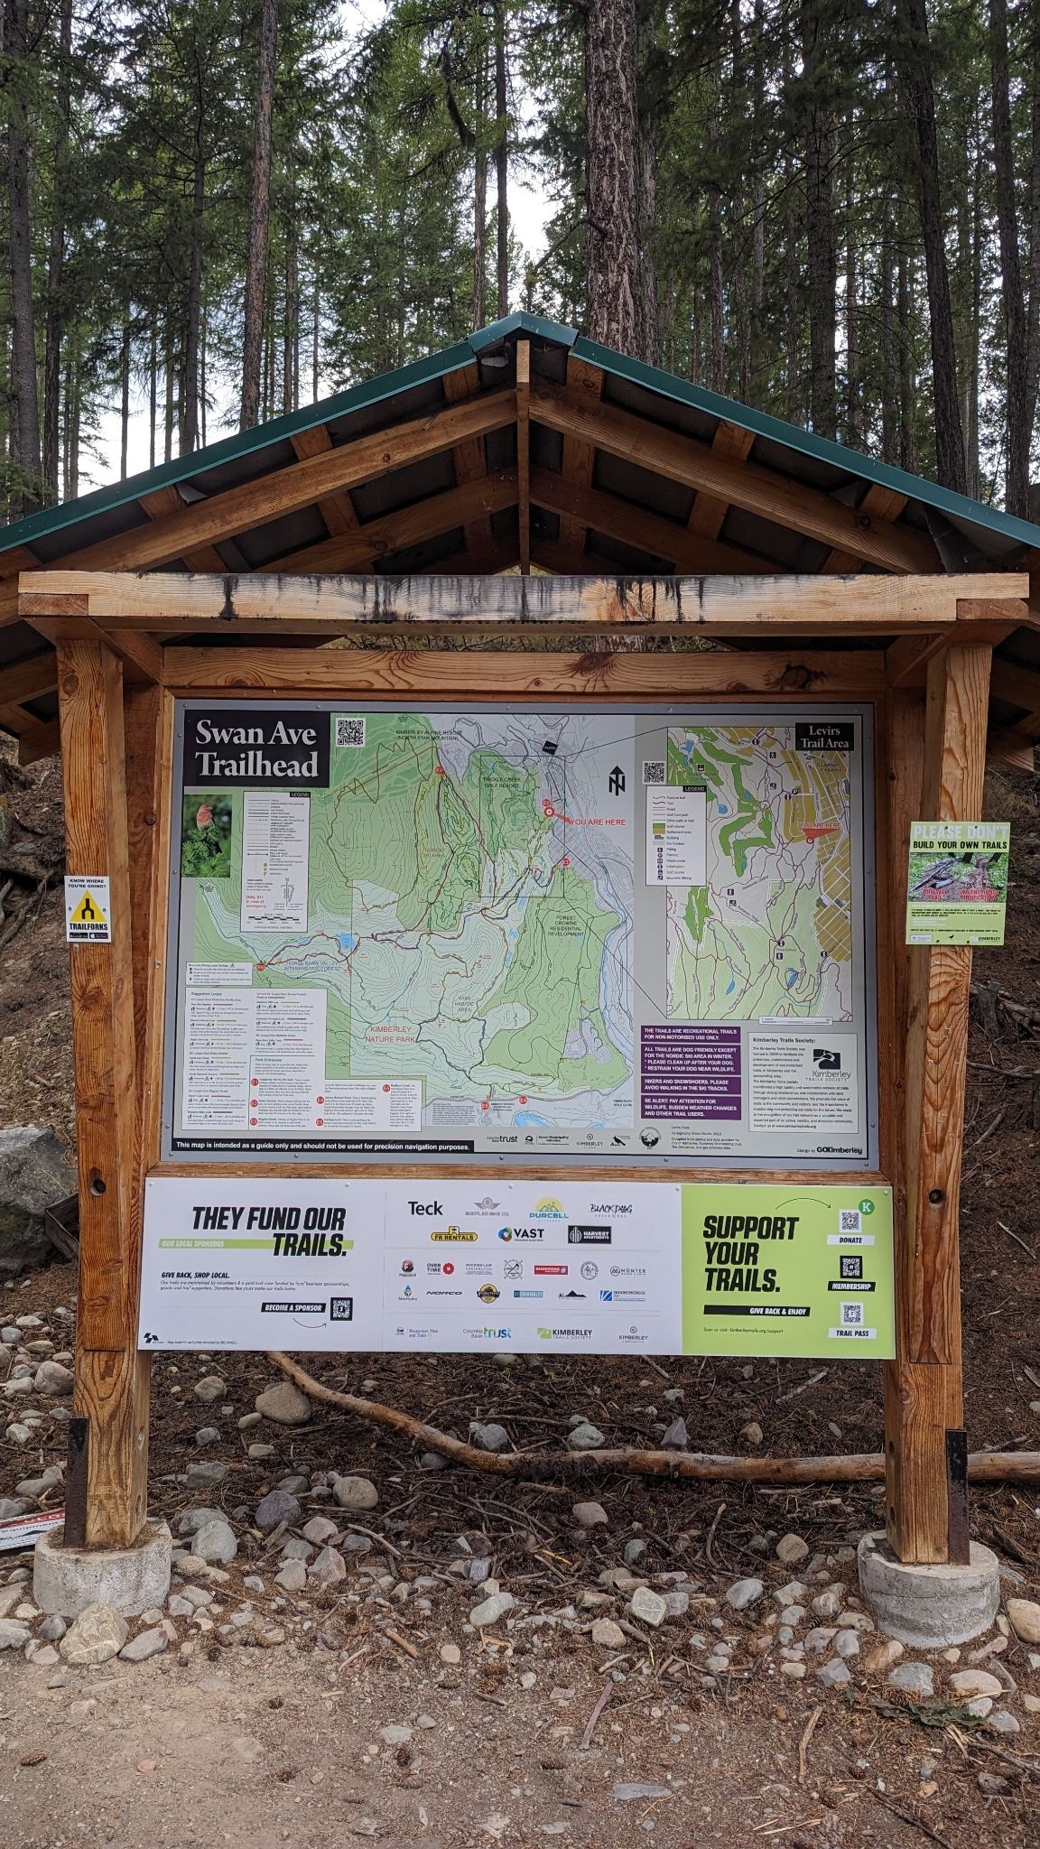
Sponsor Recognition
7 sponsor kiosk board installed
→ 3 more coming for 2024

Slide 41
Added Sponsor perks for 2023
Trailhead signage
New Bike Park sponsorship package 2023 / 2024 / 2025
Shoulder Season Movie Night
More sponsor banners at RTM
2023 Fall Raffle sponsor - Win Ski Package / Fat Bike
TCT Video exposure, beyond our network

Slide 42
SPECIAL THANKS
All three outdoor stores renewed their sponsorships and stepped up to Platinum in 2023, allowing trail crew to stay employed and keep our trails maintained.
THANK YOU!

Slide 43
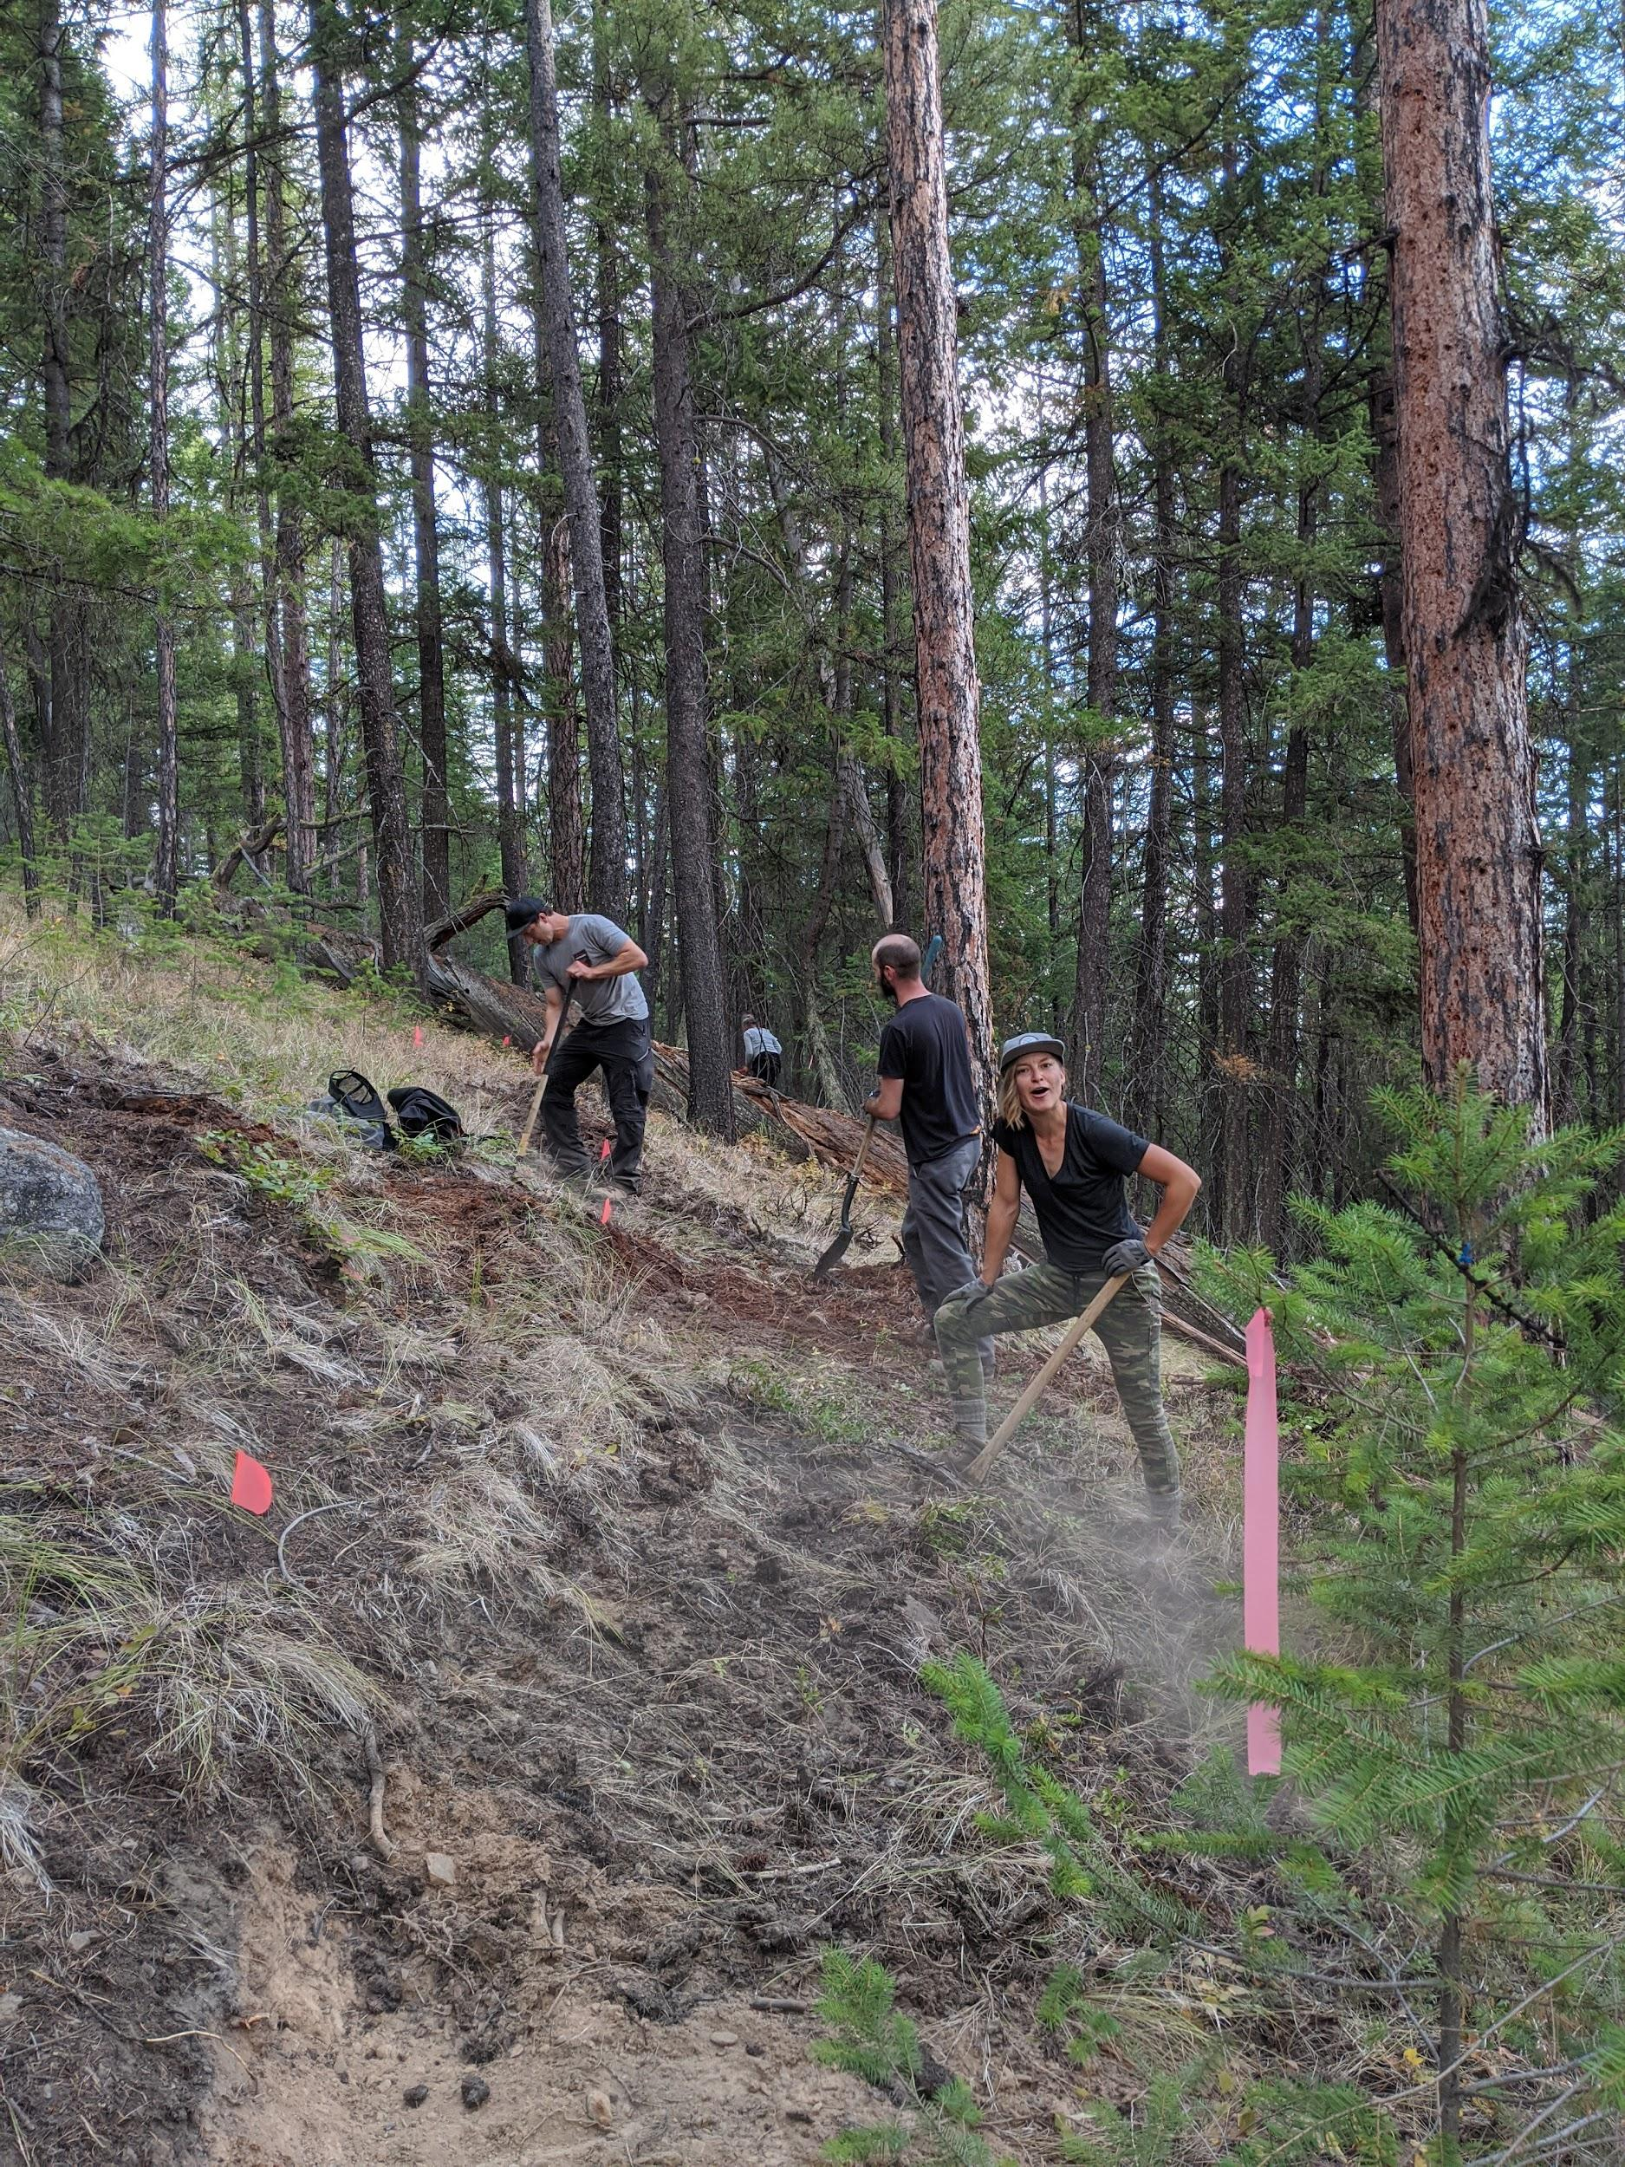
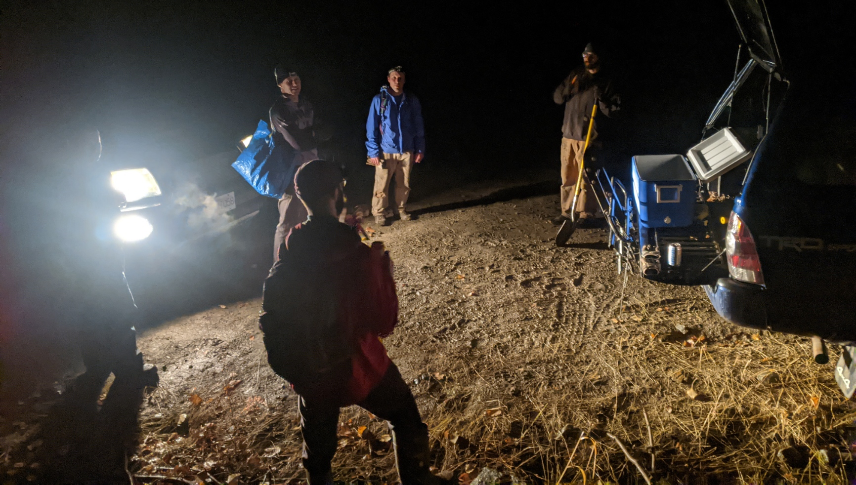
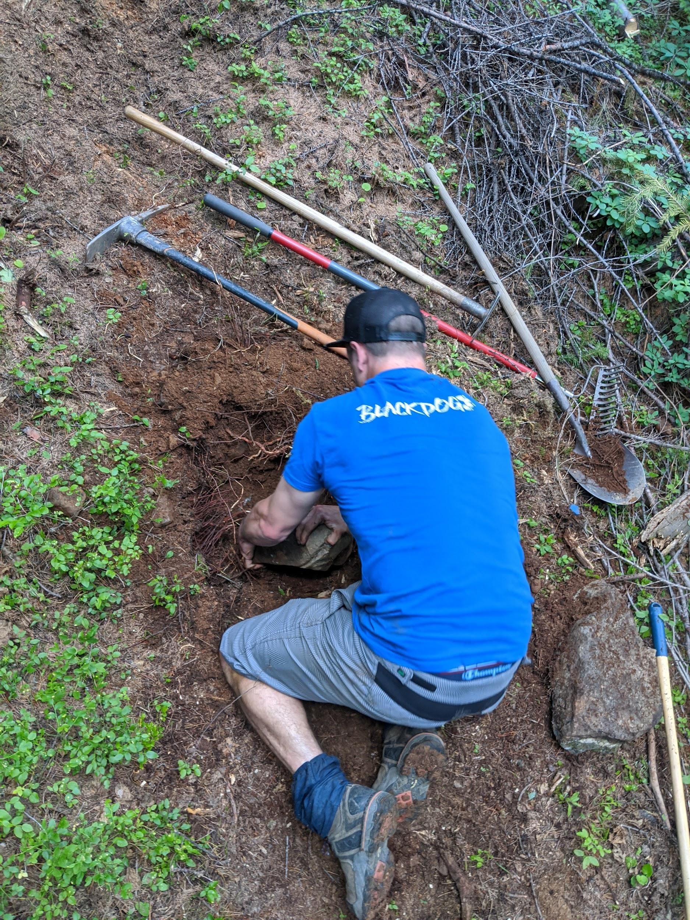
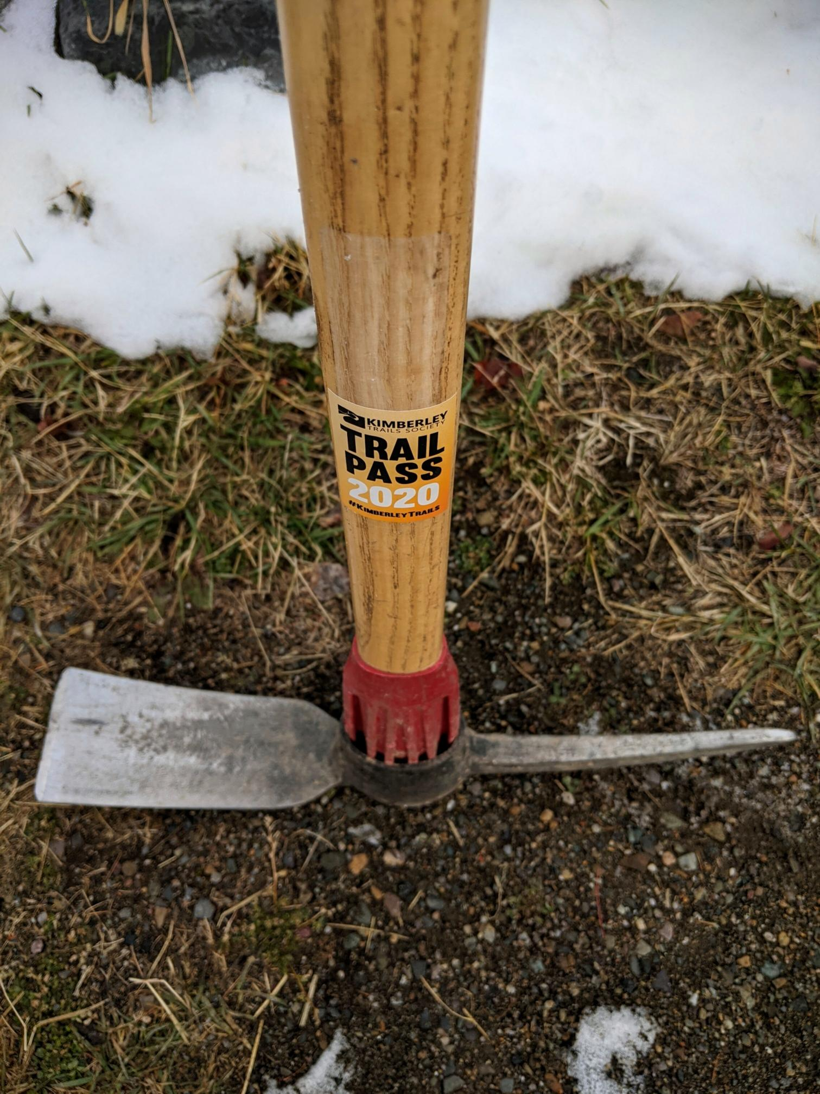
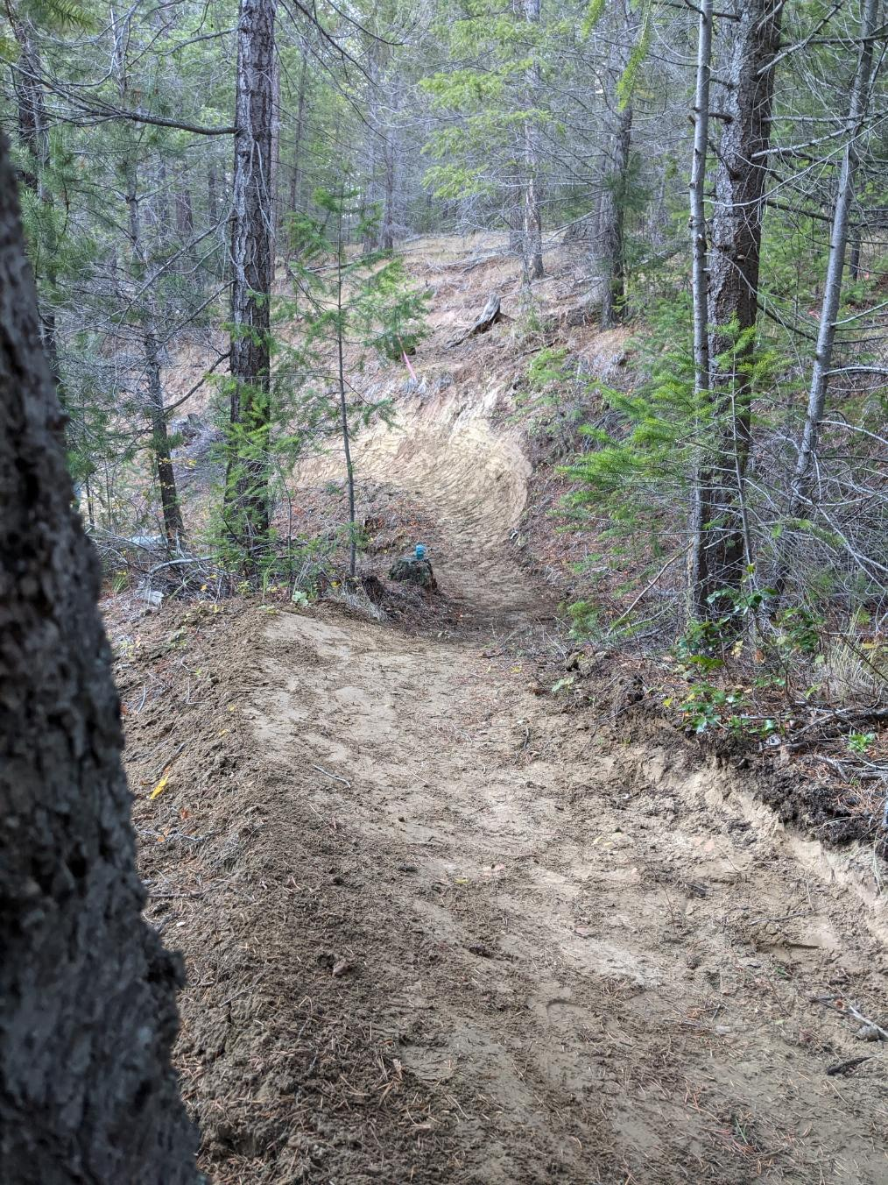
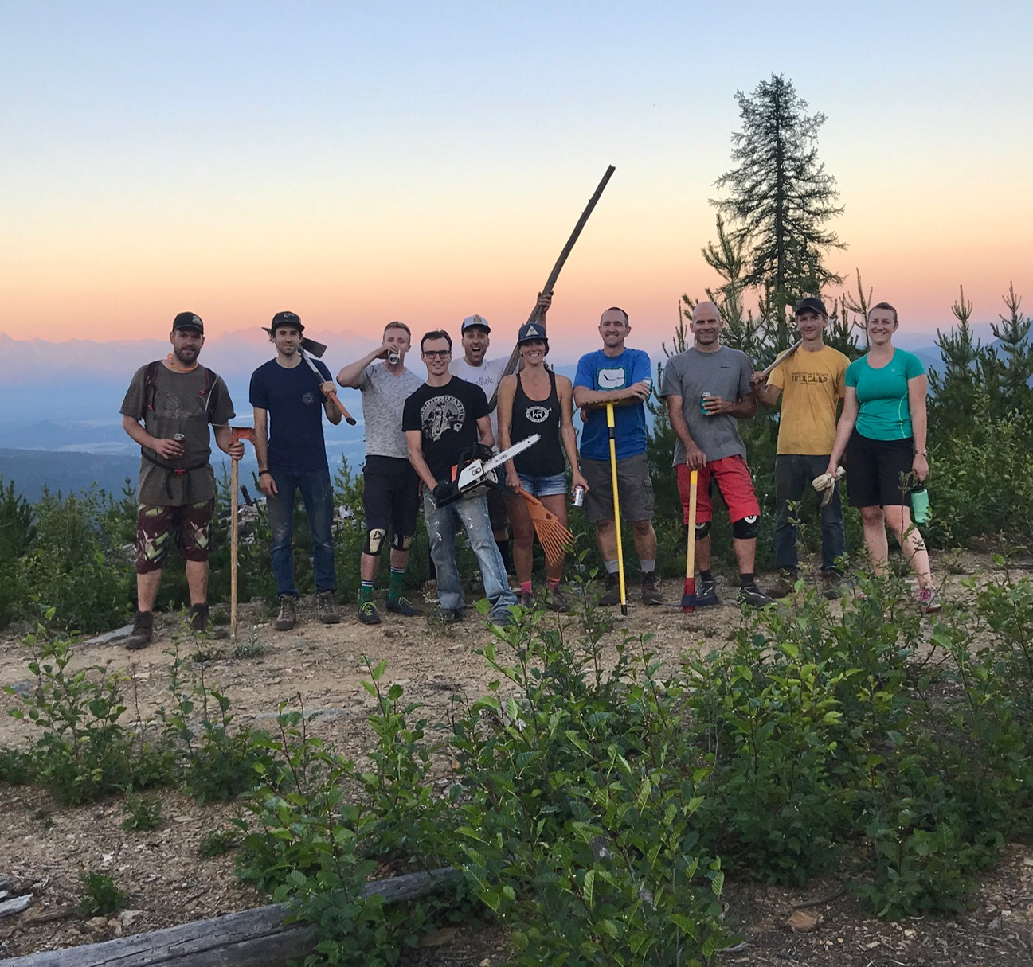
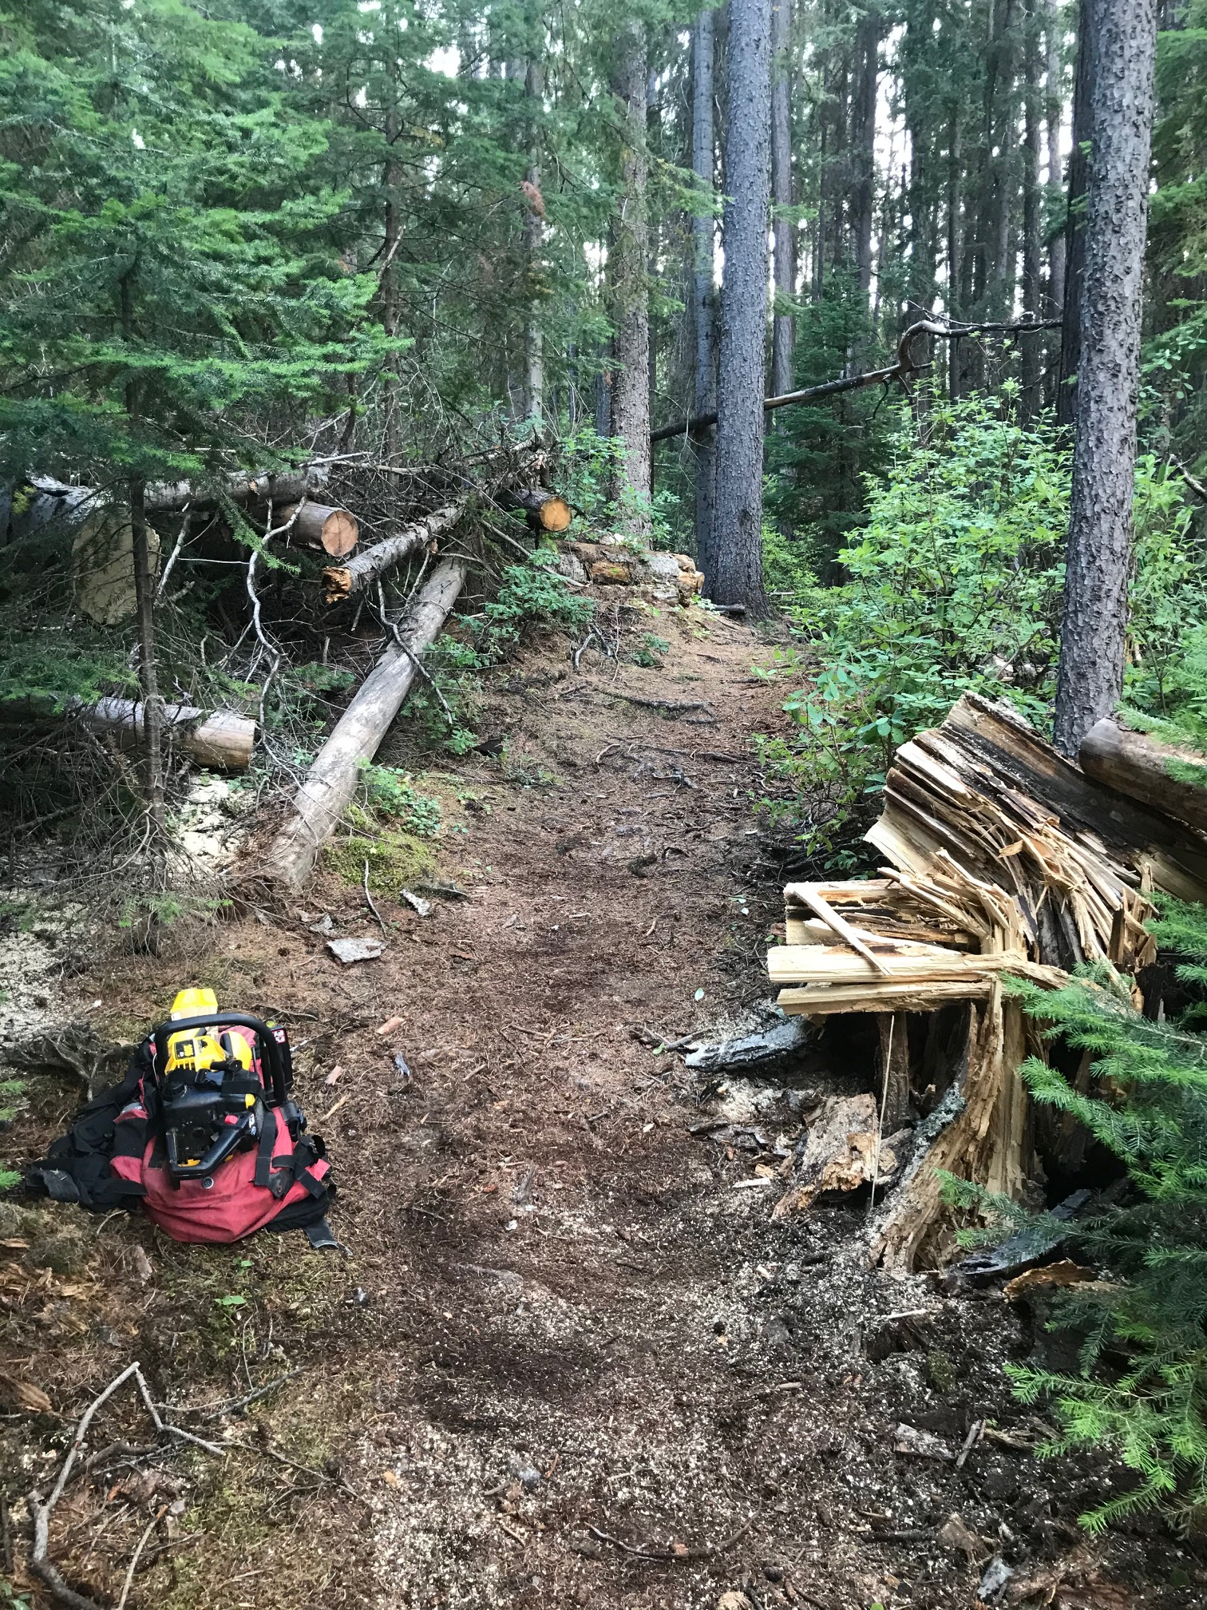
THANKS TO ALL VOLUNTEERS
FOR ANOTHER GREAT YEAR!

Slide 44
RETURNING DIRECTORS: 2024
Stephanie Boulanger
Peter McConnachie
Kenton Lane
P.J. Hunton
Stephen Williams
Pascal Gray
Athena Knibbs
Dan Mccutcheon
Kenny Larkin
Kayla Lissel
Liz Bend
Notes:
Room for up to 12 directors

Slide 45
OUTGOING DIRECTORS & VACANCIES: 2024
Thanks for all of your support.
Gillian Horton (Secretary)
Kenton Lane (Treasurer)
Neil Ross
Open Positions -
Secretary
Treasurer
Nominations to admin@kimberleytrails.org
Please include
Information about yourself
Why you want to join the KTS board
Which Position you would like to apply for
Notes:
Room for up to 12 directors

Slide 46
TCT Volunteer Recognition

Slide 47
SEE YOU ON THE TRAILS!

Slide 48
TCT Signature Trail Day

